Slide 1
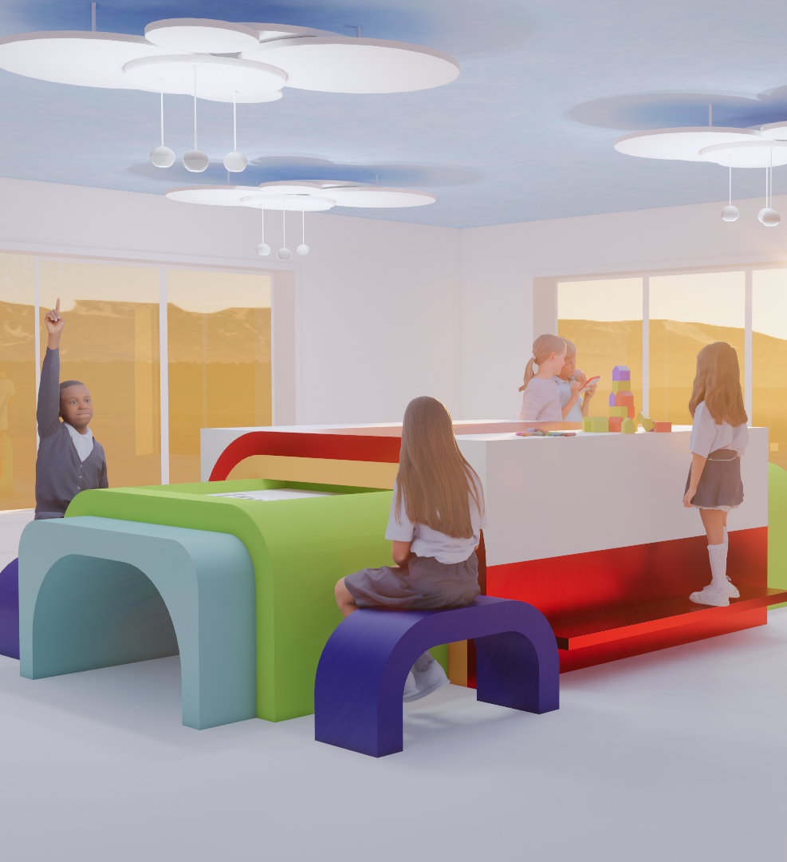

2027 FORM Student
Innovation Competition
Entry Guide

Slide 2
1
Table of Contents
About the Competition & How to Enter 2-16
Product Overview 17-37
Previous Winning FORM Competition Designs 38-47

Slide 3
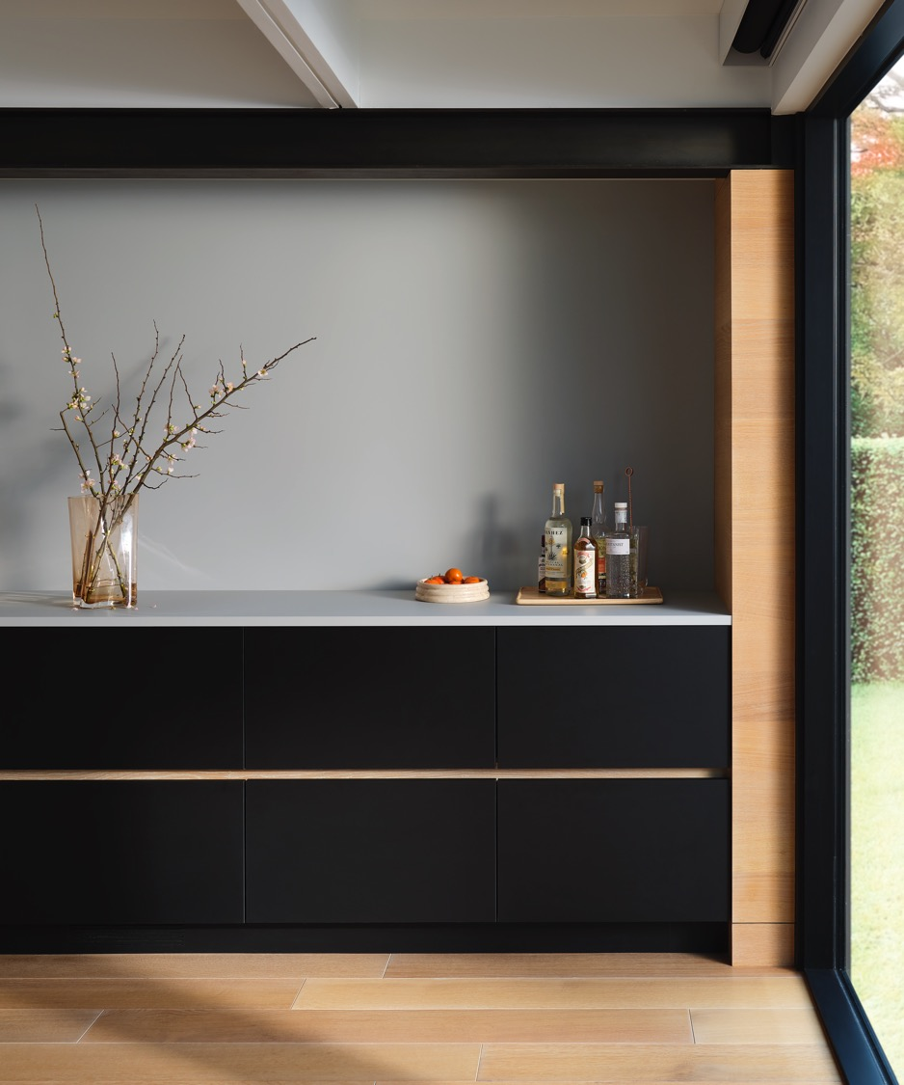
2
About the Competition
& How to Enter

Slide 4
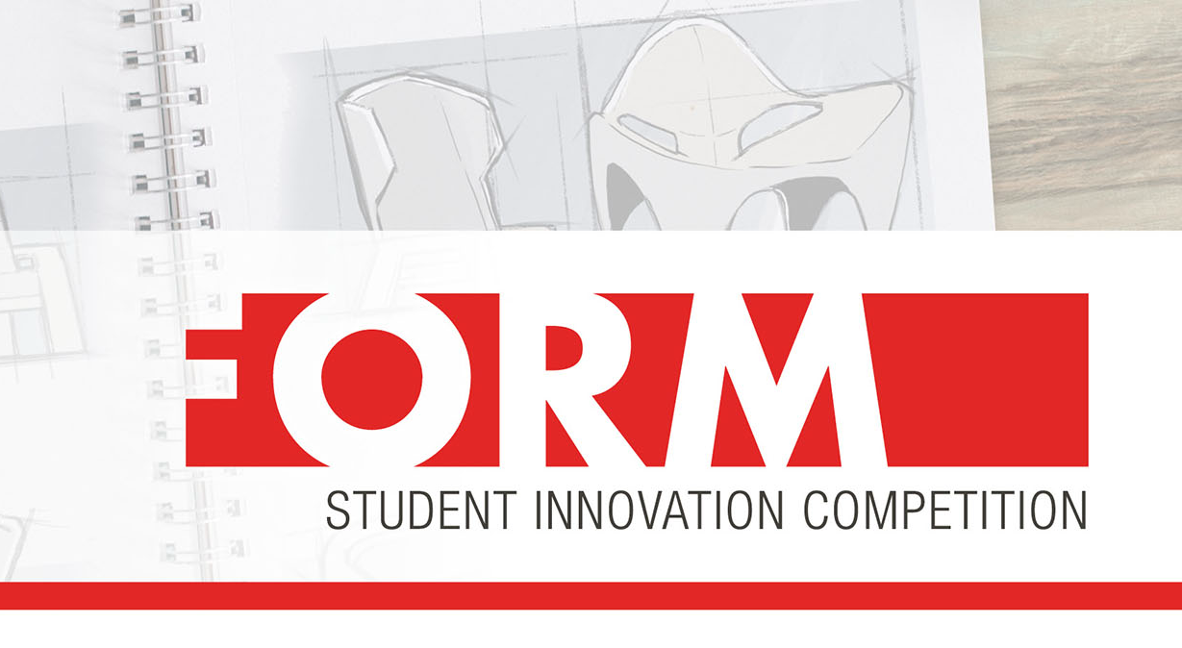
3
About the FORM Student
Innovation Competition
Now in its tenth year, the FORM Student Innovation Competition invites students studying architecture and design in the United States, Canada and Mexico to enter unique furniture designs aligned with this year’s theme of “Color as the Main Character” for a chance to win a cash prize and a trip to join Formica Corporation at NeoCon 2027, where the grand-prizewinner’s design will be fabricated on display. Furniture designs can include chairs, desks, cabinets and more — the sky is the limit and students are encouraged to use their imagination!
A distinguished panel of industry leaders will judge submissions and award three winners. For the best chances at creating a winning entry, students should review this entry guide prior to preparing designs.
Contact formica@clynch.com with any questions and good luck to this year’s entrants!

Slide 5
4
Competition Key Dates
Week of May 13
Public announcement of winner
February 19, 2027
Competition closes
August 20, 2026
Competition opens
By mid-April 2027
Competition finalists and winners are notified
June 2027
Top 3 winners will be invited to attend NeoCon 2027 with Formica Corporation

Slide 6
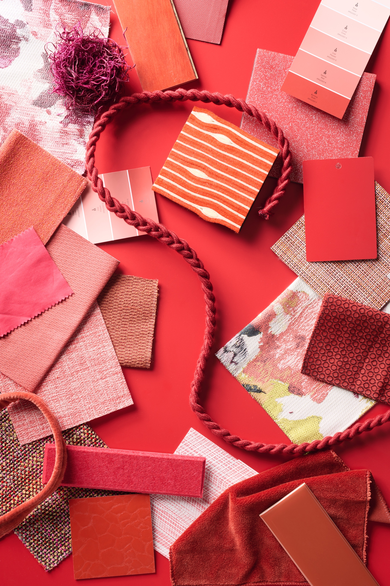
5
Theme: Color as the Main Character
Color is increasingly emerging as a defining design strategy and principle rather than just an accent. In honor of this, Formica Corporation is inviting students to make color shine as the main character of their design — from bold, saturated hues to unexpected, dimensional and layered color combinations — and explore how color can shape user experience.
Pieces must be designed for indoor use in any residential and commercial setting and must incorporate at least three or more Formica® Brand* or FENIX® products.
*Includes product lines within the Formica ® Portfolio of Surfacing Solutions such as Homapal ® Metal Laminates, Everform ® Solid Surface and InDepth Surfacing™ (see pages 15-34 for additional product lines and information). Any combination of these product lines counts toward the three-product minimum.

Slide 7
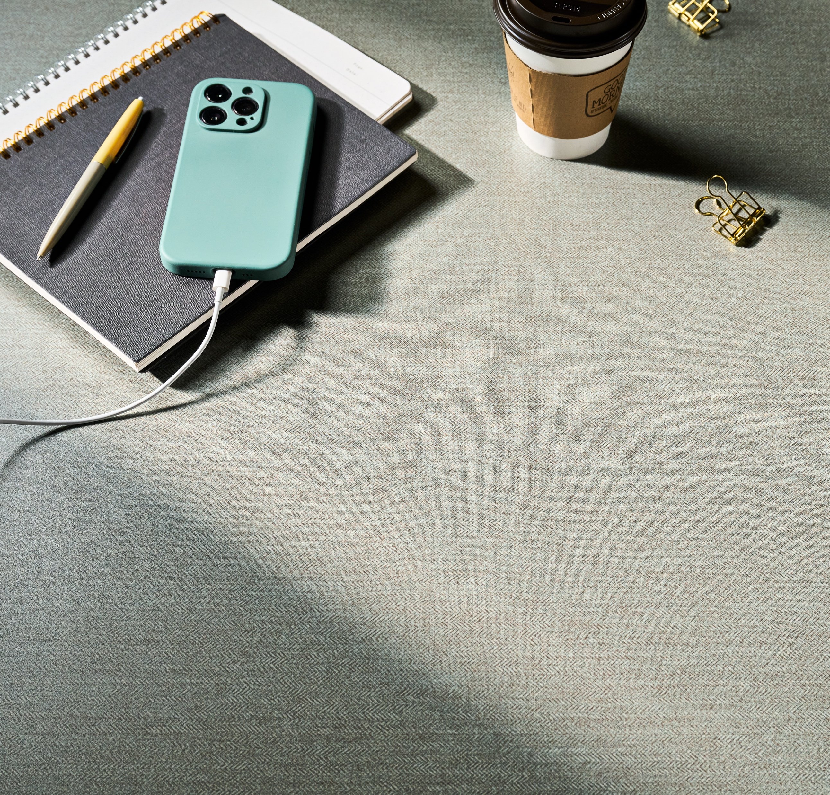
6
Eligibility
The 2027 FORM Student Innovation Competition is open to students who are at least 18 years of age and legal permanent residents of the United States, District of Columbia, Canada or Mexico, or who are international students enrolled as full-time students at universities in those locations.
The competition is not open to students who are currently employed as a professional designer in any capacity except as an intern.
You may enter as an individual or as a team of no more than two. If entering as a team, both members of the team must meet the competition eligibility requirements. Winning teams will be responsible for splitting prizes.
Please review complete eligibility requirements in the Competition Rules, available for download on www.formica.com/studentcompetition

Slide 8
7
Requirements for Entry
Design Packet requirements
Your Design Packet must:
Be uploaded as a PDF no larger than 10MB in size
Include a design statement in English up to 300 words
  You may also include your design statement in your native language (Spanish, French)
  You may use a translation service to translate your design statement and note that you’ve done so in your entry (optional)
  Errors caused by translation are permissible and will not impact your ability to win
Include a color rendering of your design with dimensions
  Note that designed pieces must be no larger than 6 x 6 x 6 feet, or at least able to be broken down to fit inside a single 6 x 6 x 6-foot shipping crate.
Optionally, your Design Packet may include additional supporting visuals/renderings or CAD drawings, but they must be included in your Design Packet PDF. If you are submitting CAD drawings in Spanish or French, please include an English translation.
If not included in the initial Design Packet, during the judging period Formica Corporation will request a workable .dwg or .dwf file (in English) of the top 10 finalists’ designs to assist in determining feasibility of fabricating it.

Slide 9
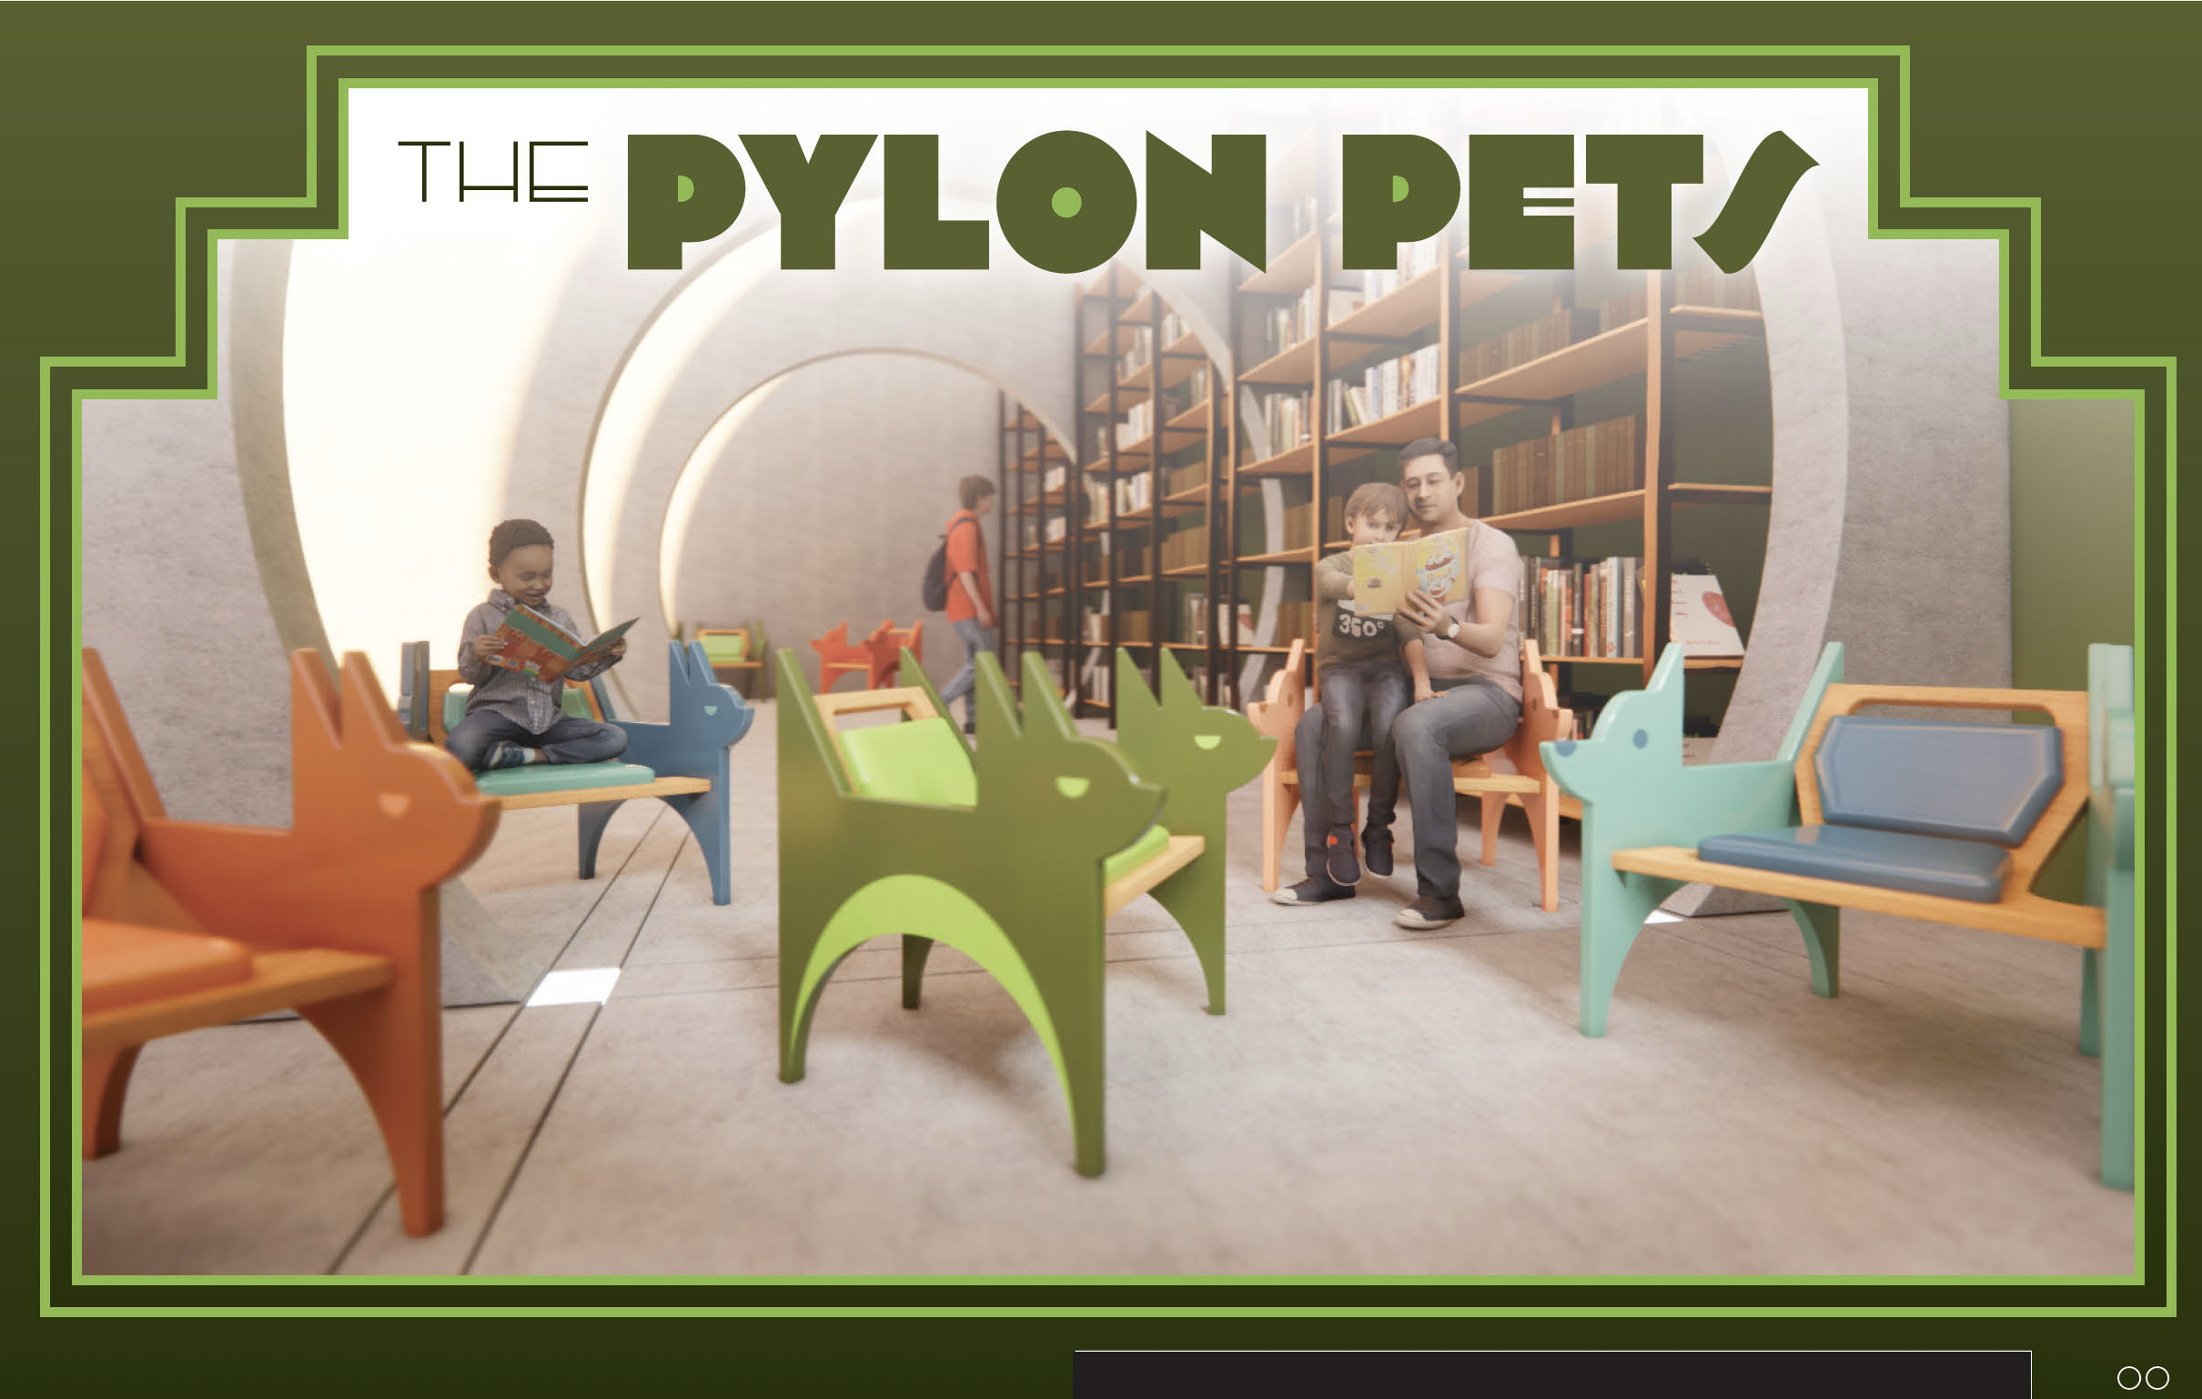
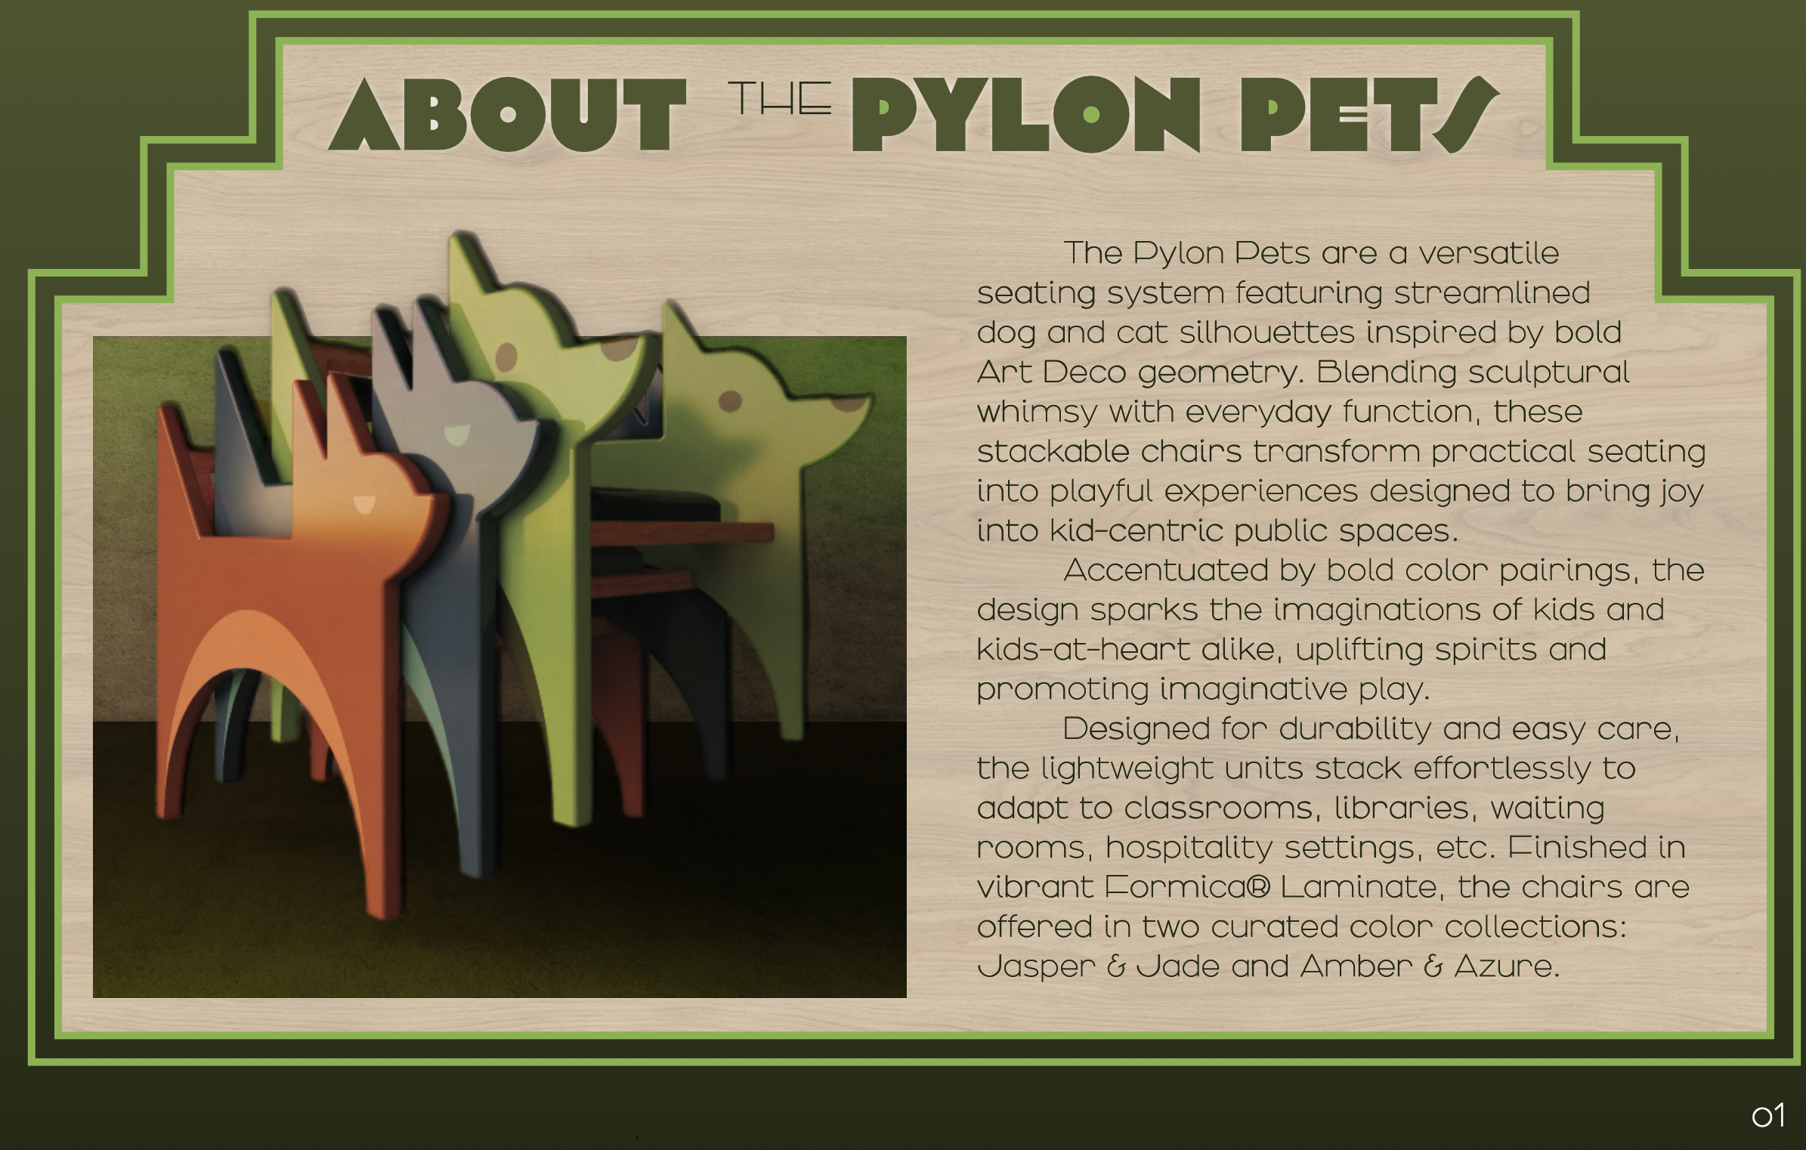
8
Design Packet Example
Below are Design Packet pages from a previous winning entry, meant to serve as an example for reference. Please refer to page 7 for minimum requirements for your own Design Packet.

Slide 10
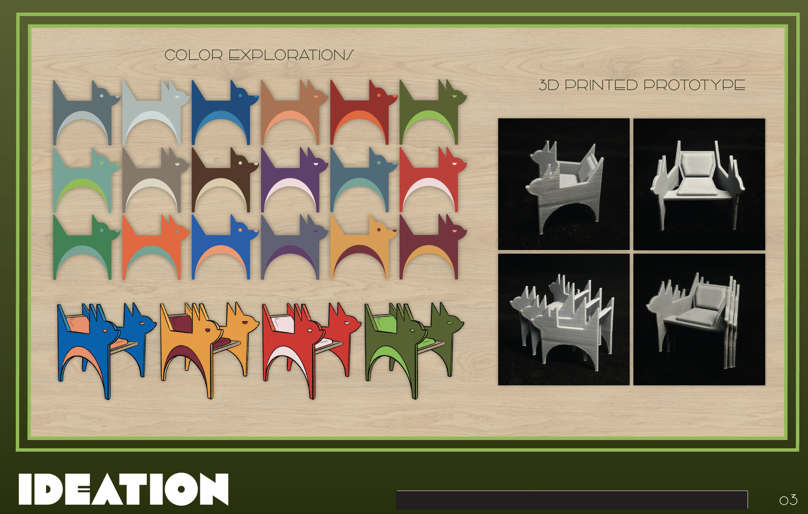
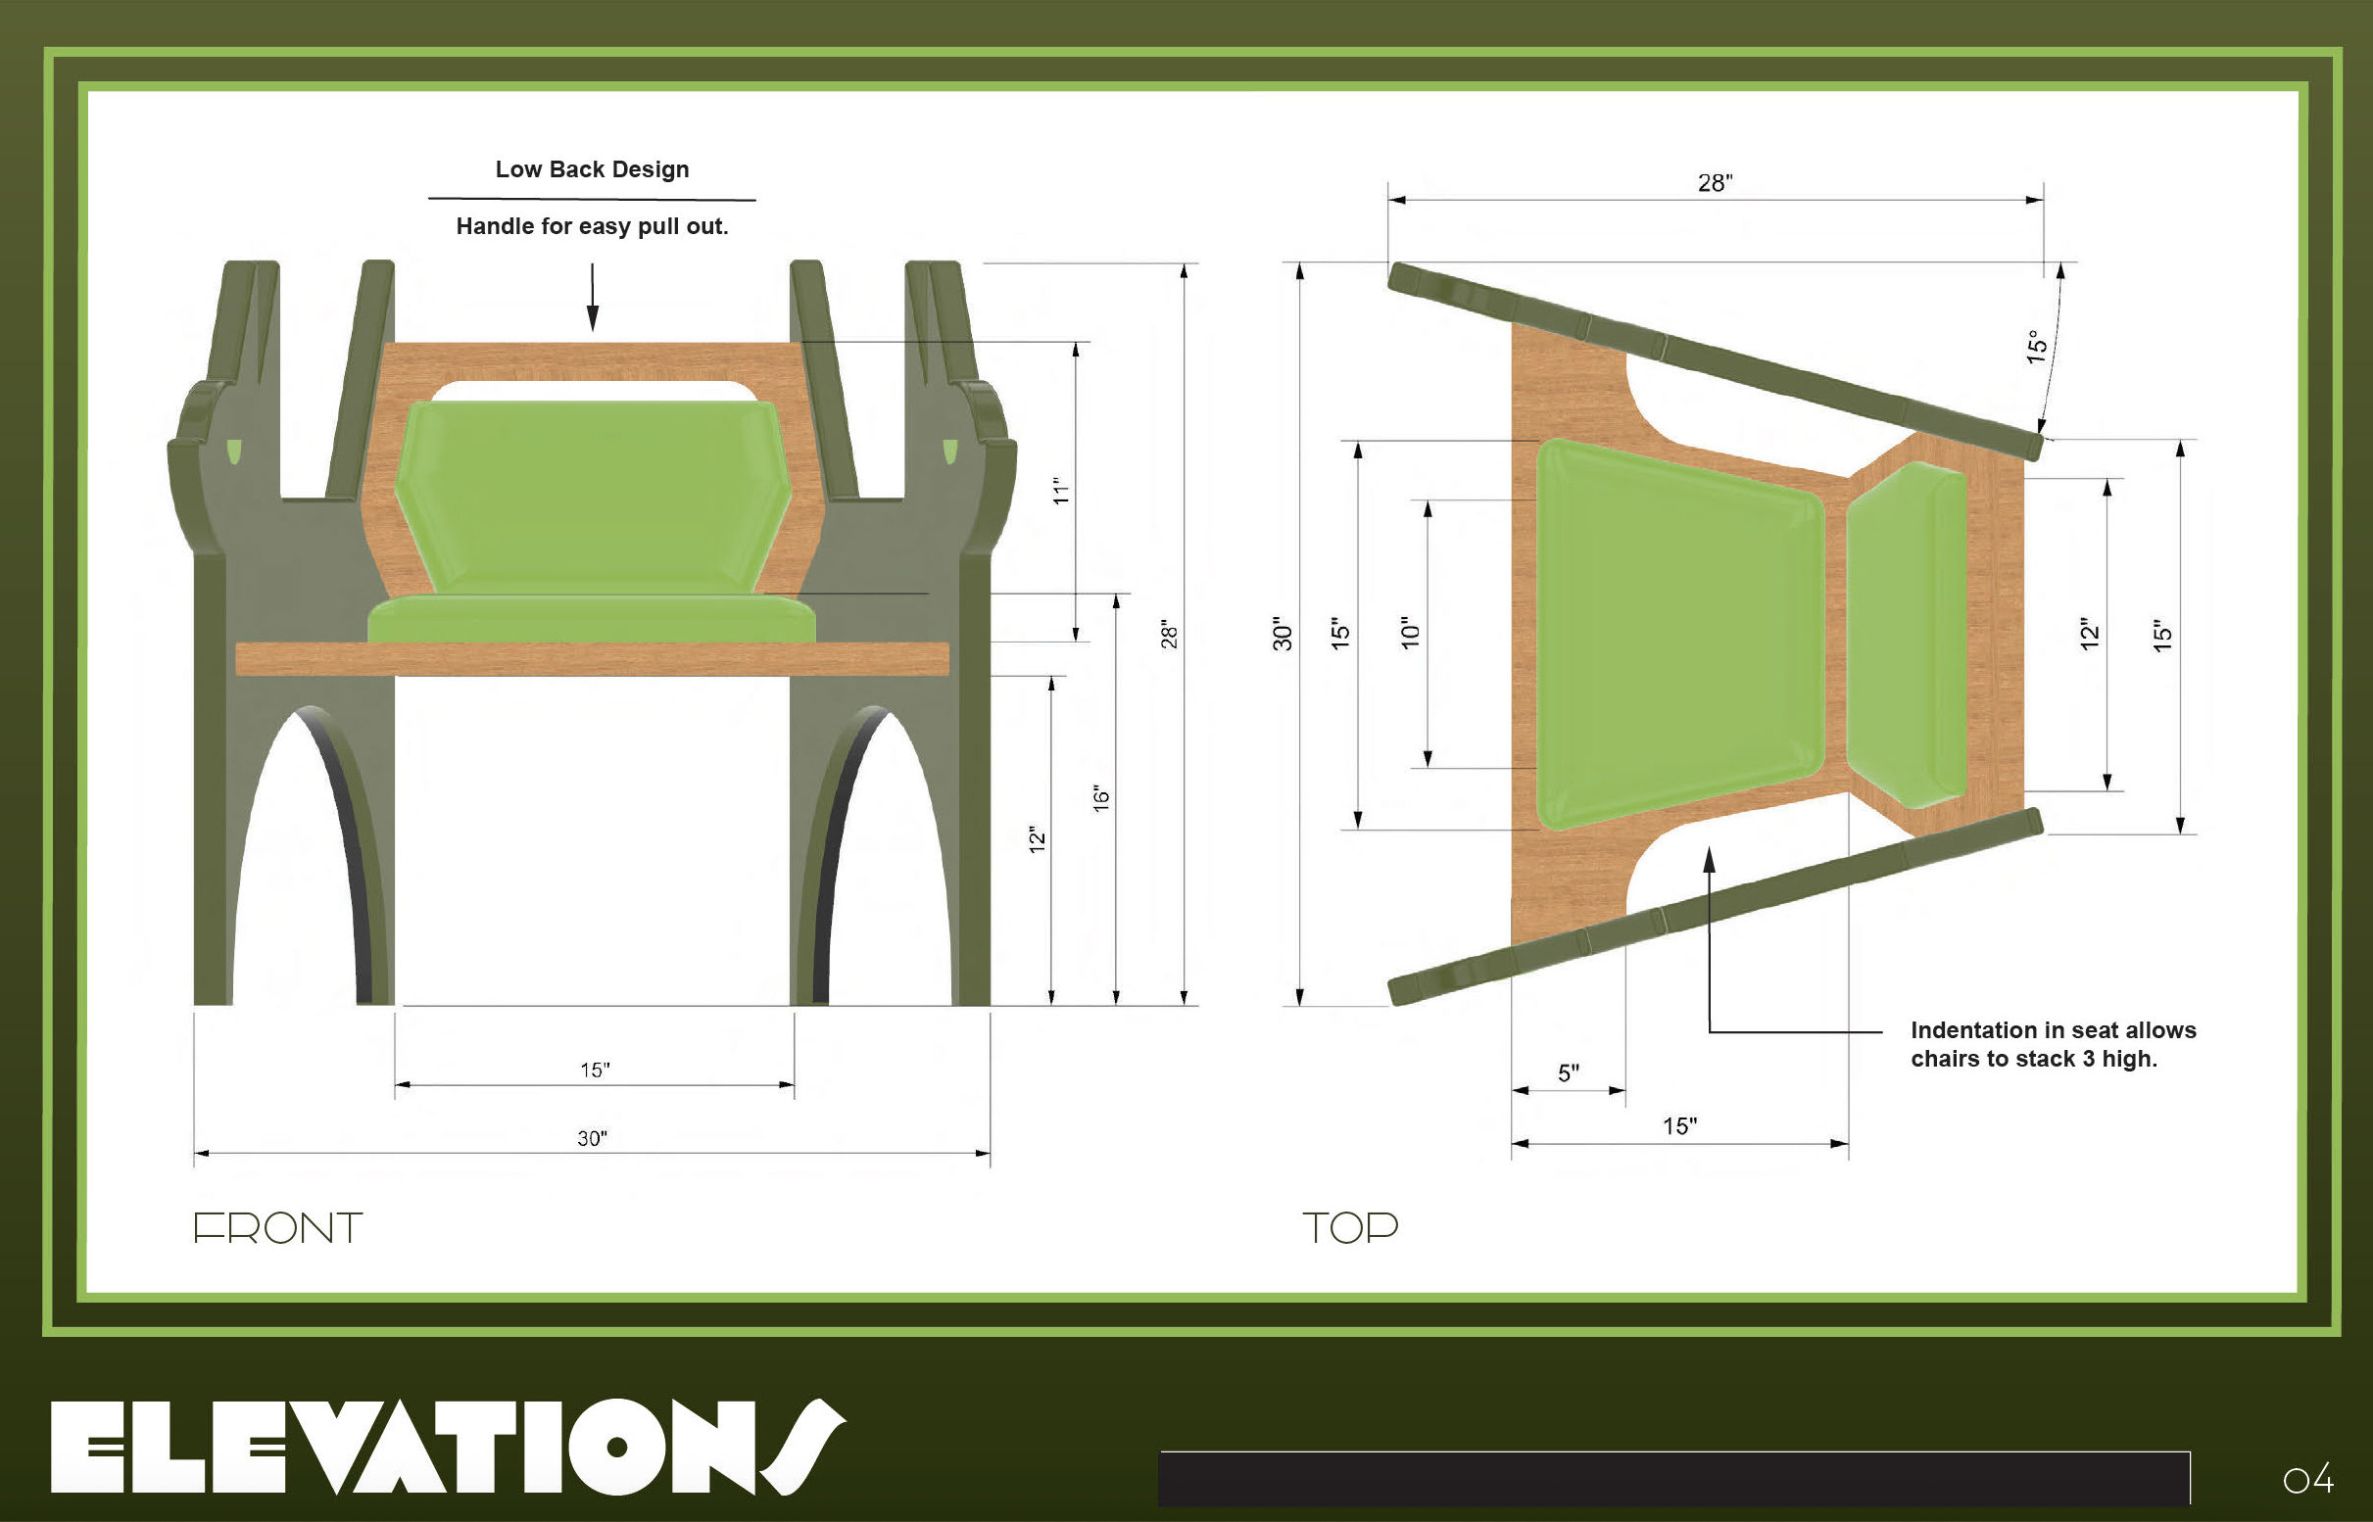
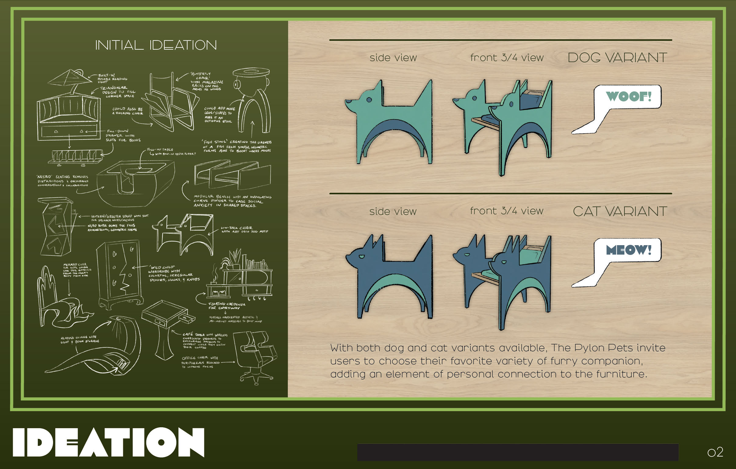
9
Design Packet Example

Slide 11
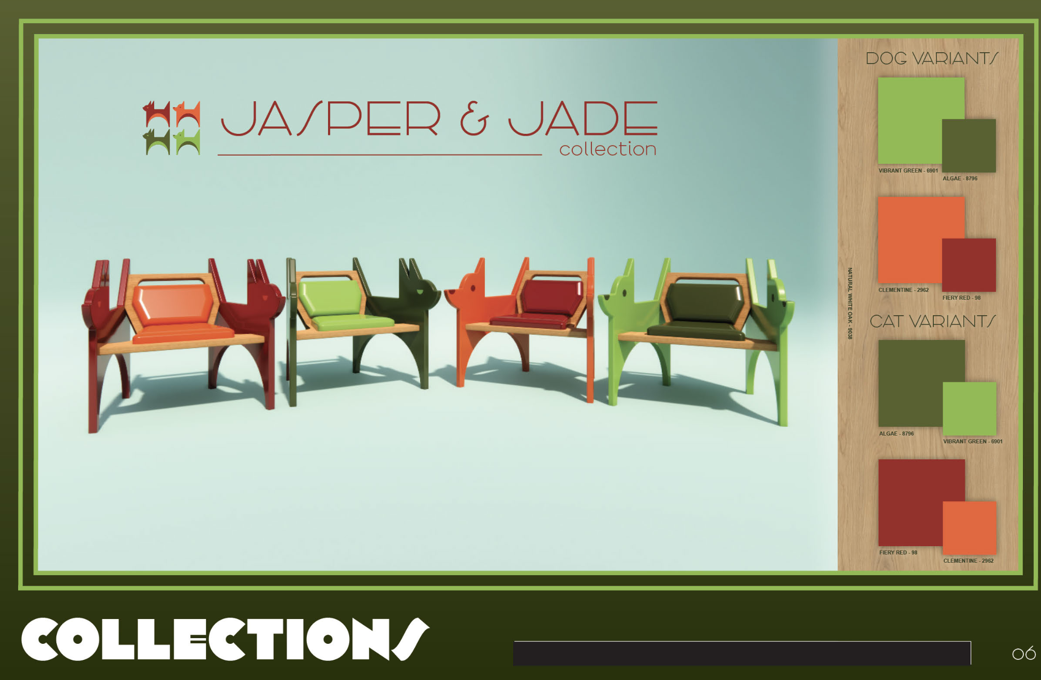
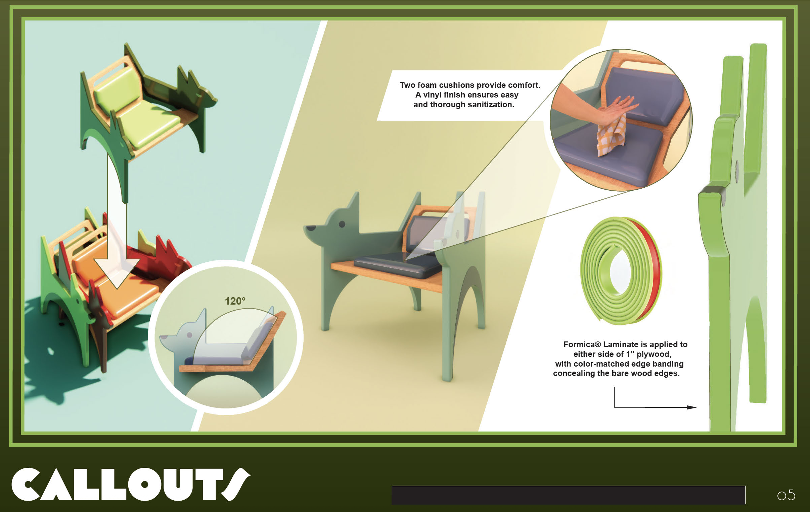
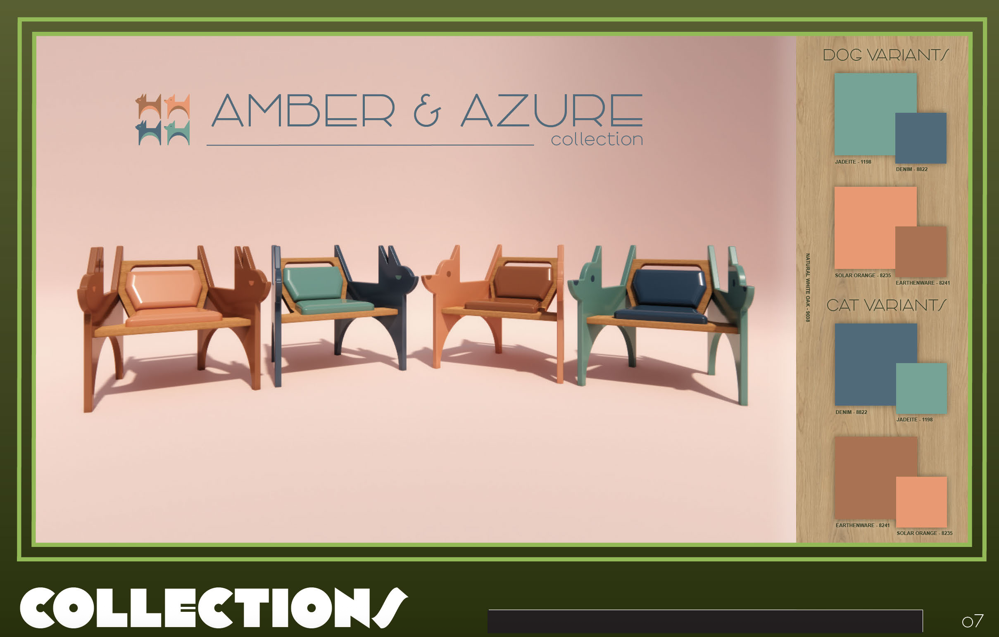
10
Design Packet Example

Slide 12
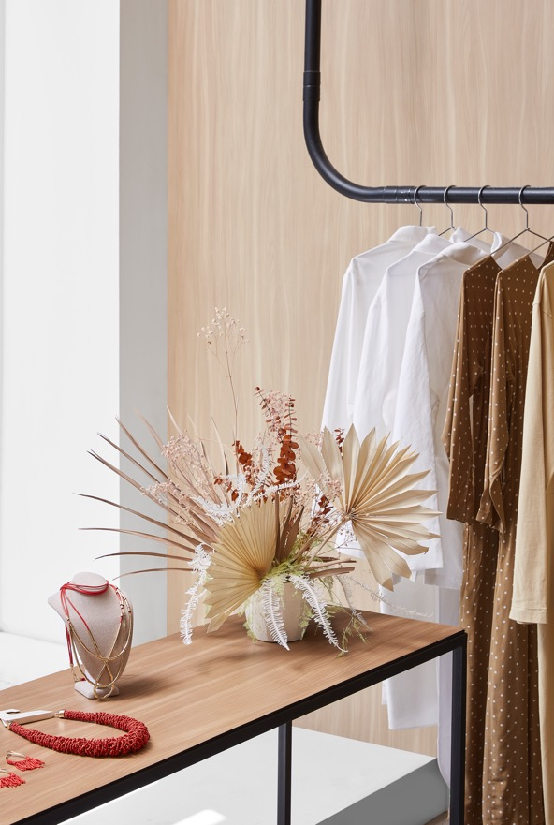
11
Requirements for Entry
Understand working with laminate
  Laminate can be used for a large variety of surfacing projects and locations throughout the home and commercial spaces, including but not limited to:
  Countertops
  Backsplashes
  Cabinet fronts
  Dividing walls
  Case work
  Desks
  Shelving
  Elevator panels
  Walls
Note that while some Formica® Laminate patterns are named after cloth, fabric or stone — the materials high-pressure laminate patterns resemble — Formica Corporation does not manufacture these materials. You may include real cloth or stone in your design, but they do not count toward the required minimum of three Formica® Brand or FENIX® Laminate materials.

Slide 13
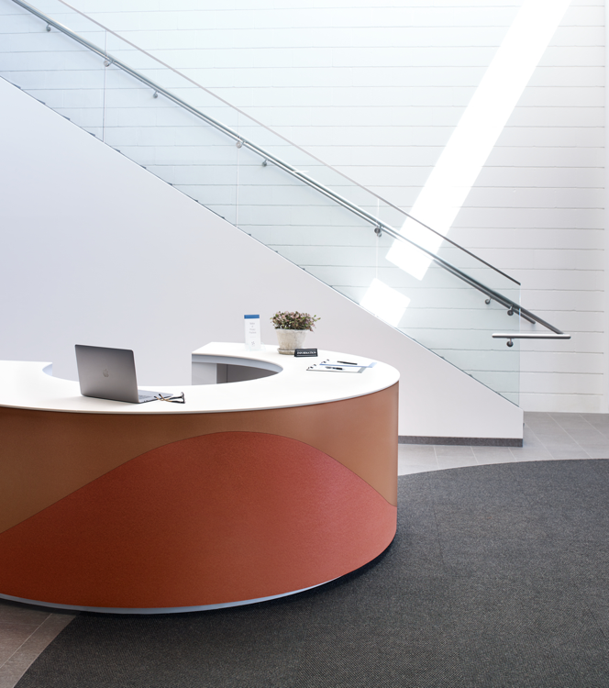
12
Requirements for Entry
Understand working with laminate, continued
Formica® Laminate can be bent (within limits) through postforming at 325 degrees Fahrenheit. Forming rounded shapes can be more difficult and gradual curves are recommended. For instance, Formica® Laminate cannot:
Be twisted like pasta
Be formed into spheres or globes
Be shaped into continuous loops or coils
Formica® Laminate must be glued to a substrate like MDF, plywood or another rigid material. Keep this in mind as you develop your design.
Formica® Laminate is not recommended for outdoor use. Please design pieces for indoor use only.
Careful consideration must be given to product use around water because saturation may damage the seal and paper core of laminate.

Slide 14
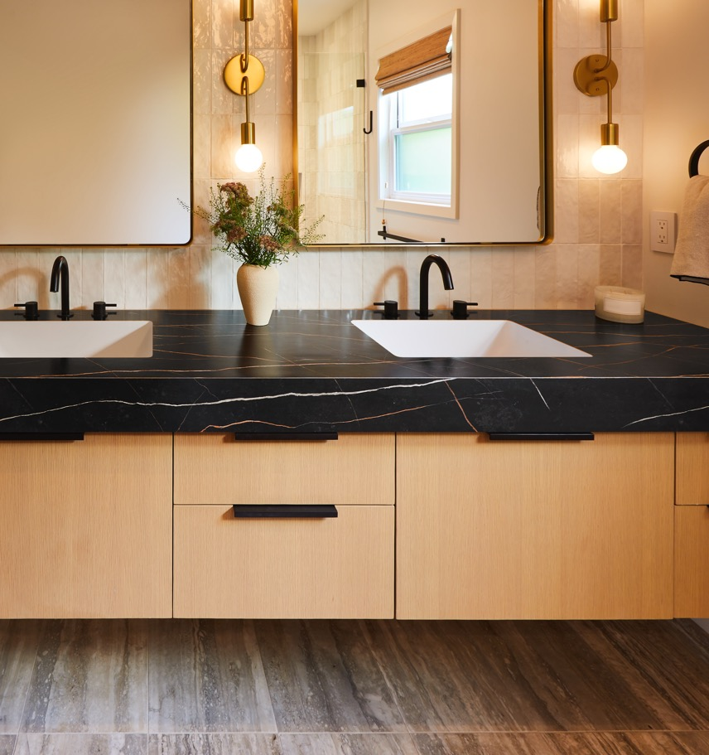
13
Requirements for Entry
Understand working with laminate, continued
Designs that can’t be fabricated aren’t eligible to win. Explore the fabrication and postforming guides located at Formica® Laminate (www.formicadocs.info), and check out the DIY Videos on Formica’s YouTube channel (http://bit.ly/4xaRyB2) to learn and visualize how the product is applied.
Please reach out to formica@clynch.com with any questions. We will do our best to get back to you as soon as possible, but please allow 3-5 business days for a response.

Slide 15
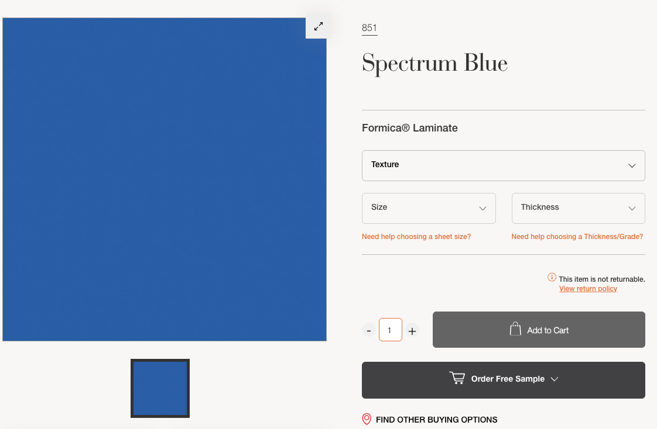
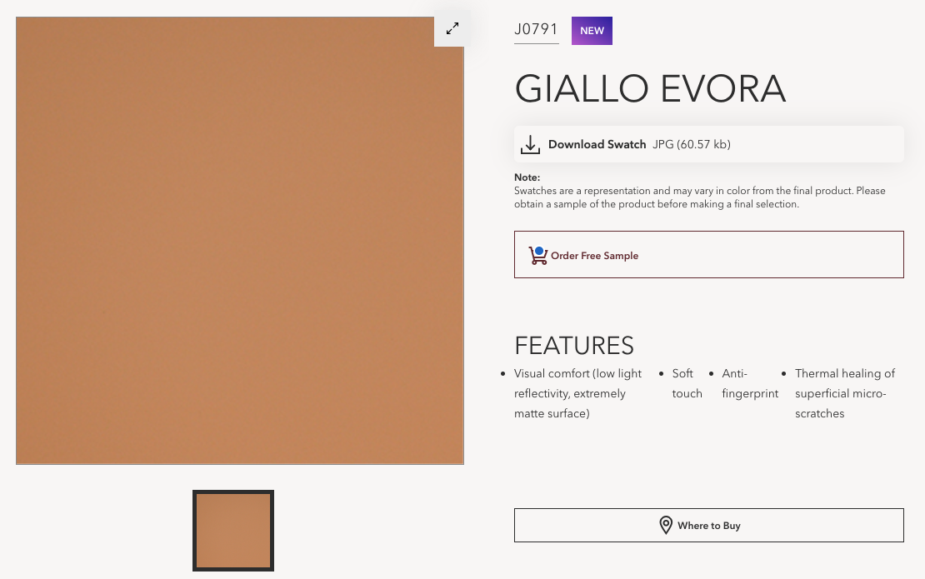
14
How to Order Free Product Samples
Samples can help you compare and visualize Formica® Laminate and FENIX® Innovative Materials designs. You can order a free sample for delivery directly from individual color landing pages, as pictured below.
Formica® Laminate (Formica.com) FENIX® North America (fenixforinteriors-na.com)

Slide 16
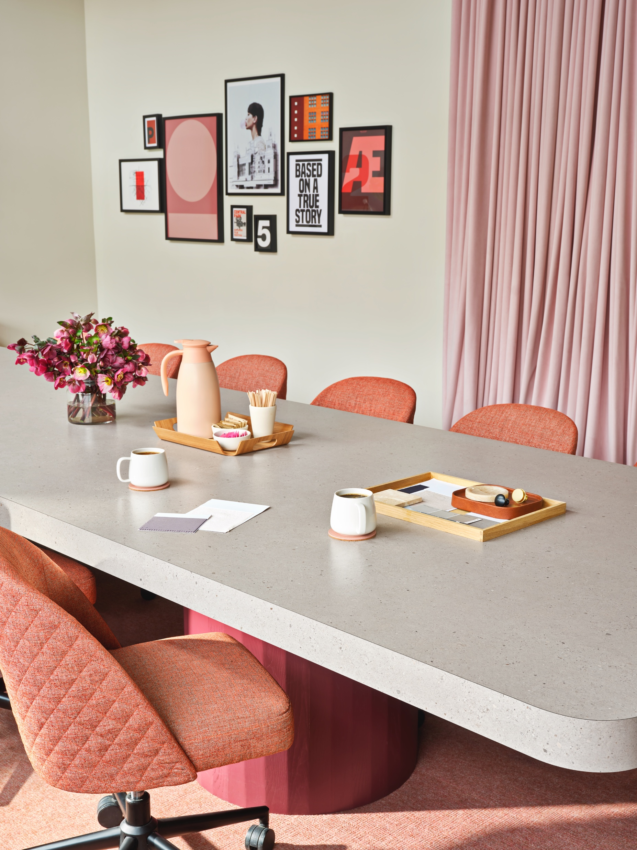
15
Judging Criteria
Submissions are evaluated based on the following criteria:
Use of Formica® Laminate Colors and Patterns (40% of score): Unique, unexpected use of Formica® Laminate and FENIX® colors and patterns, and how the chosen colors and patterns aid the understanding of the overall concept.
Overall Design Aesthetics (30% of score): The overall aesthetic and visual memorability of the design and how it uniquely, creatively or unexpectedly interprets the competition theme.
Quality of Intersection of Design and Function (20% of score): Whether the design is as beautiful as it is functional and can be feasibility executed for its intended purpose.
Project Statement (10% of score): How well the Design Statement clearly articulates the design concept, the design’s potential use cases and the importance of Formica® Laminate and FENIX® are to the overall design and function of the piece.

Slide 17
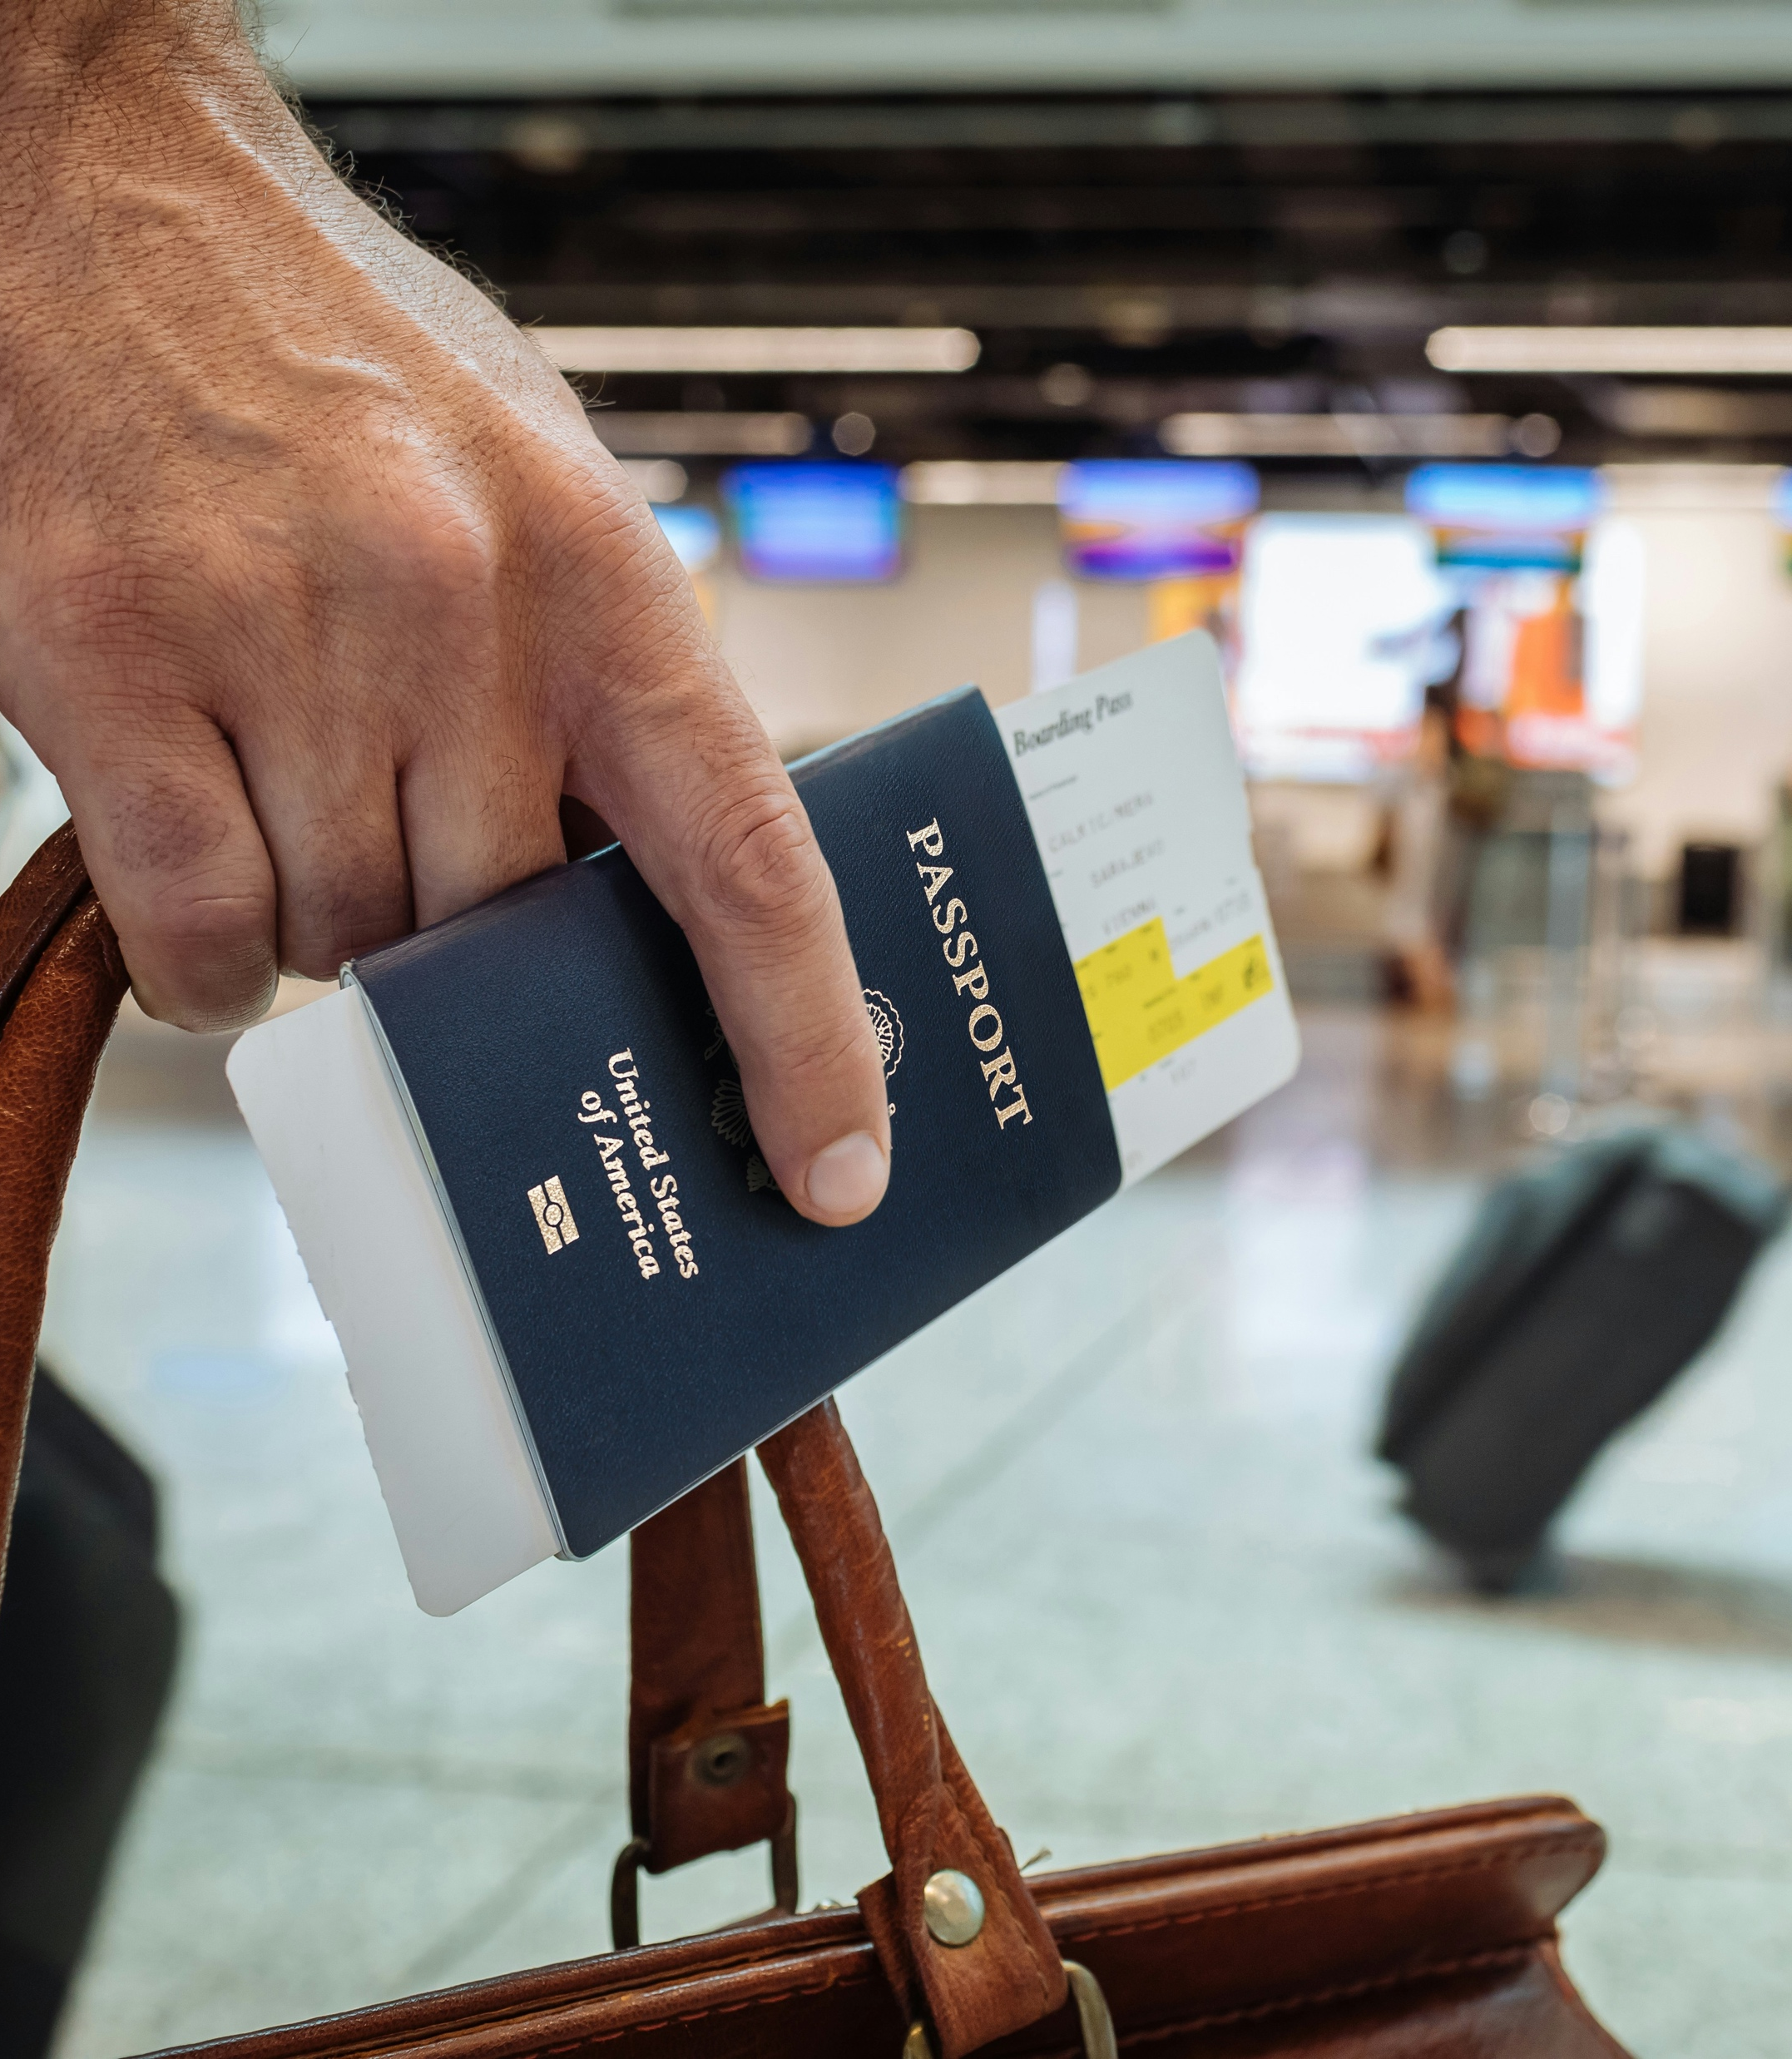
16
Considerations
Understand travel implications
While not required, it’s recommended that all entrants from Canada and Mexico understand the legal travel requirements for entering the U.S. upon entering the competition.
Winners will be notified approximately two months before NeoCon 2027, which will take place in early June 2027 in Chicago, Illinois, U.S.A. Working to secure the necessary documents to travel, such as your passport and/or visa, in advance may help you successfully obtain them in time to attend NeoCon.
Video or audio recording
Formica Corporation will contact finalists to request a brief video or audio recording of them introducing themselves and their design to confirm correct pronunciation of their names, schools and design titles.

Slide 18
17
Product Overview

Slide 19
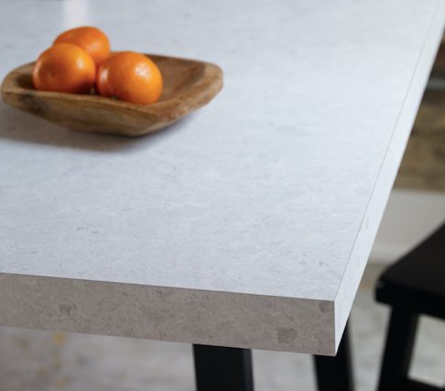
18
Formica® Laminate
A few examples of available colors are on the following slides. The full range of colors is available at Formica.com (Product Page).
Formica Corporation is the inventor of laminate. Available in a variety of solid and graphic patterns and finishes.
Traditional laminate has a paper core with layers of thin sheets.
Postforming allows the product to be used for certain curved applications.
Durable and wear-resistant.
Nonporous and easy to clean.
Horizontal and vertical application.
Impact-resistant.

Slide 20
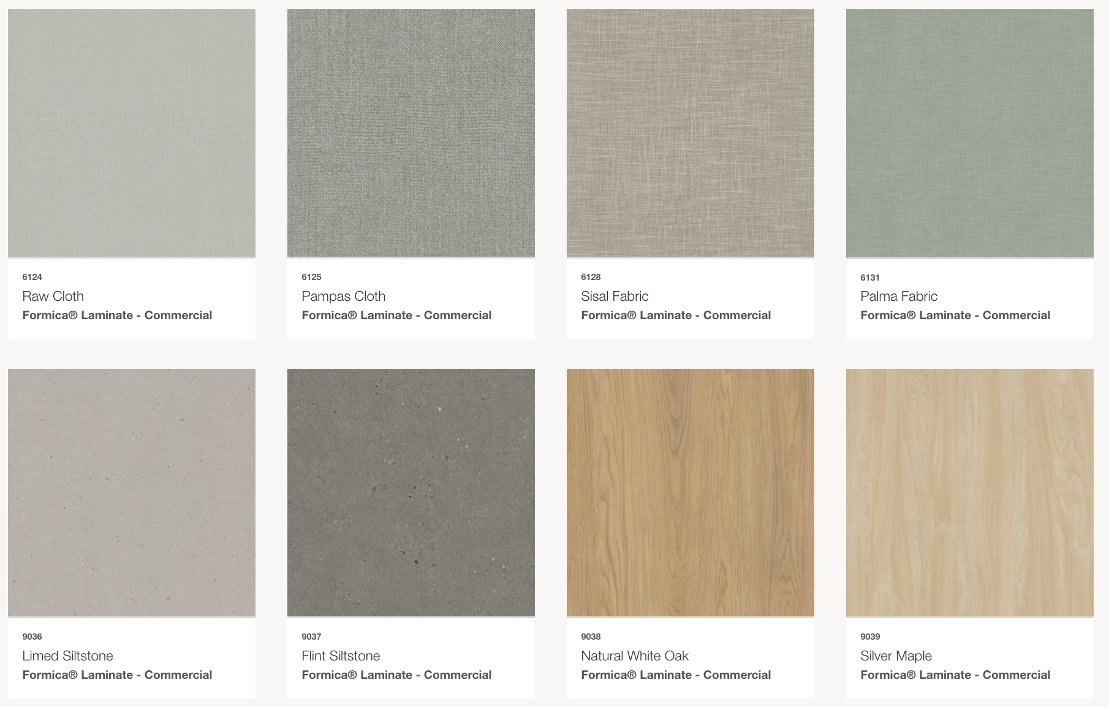
19
2025 Patterns & Woodgrains Collection – Formica® Laminate

Slide 21
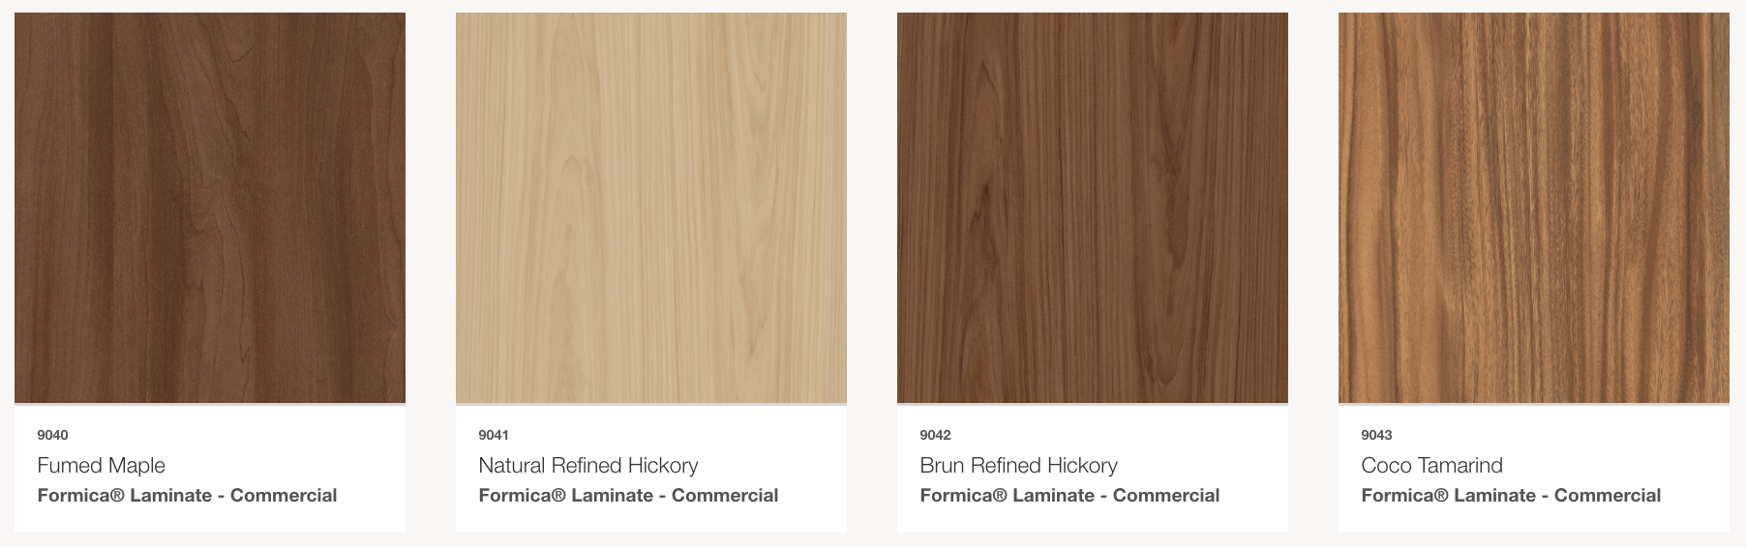
20
2025 Patterns & Woodgrains Collection – Formica® Laminate

Slide 22
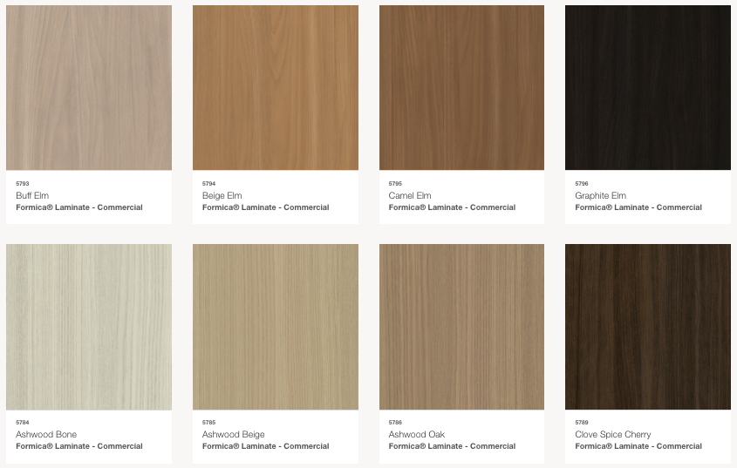
21
Woodgrain Line – Formica® Laminate

Slide 23
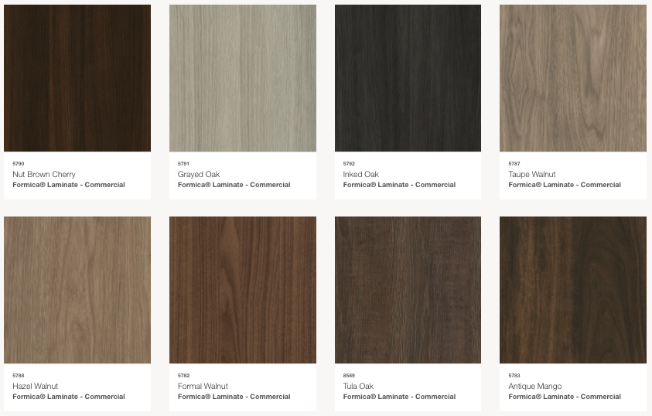
22
Woodgrain Line – Formica® Laminate

Slide 24
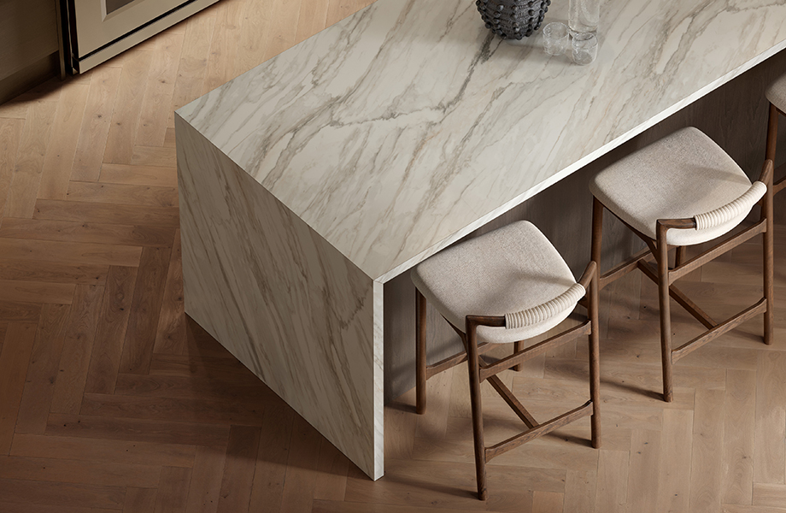
23
New Formica® Laminate Stones Collection
Product Page
From bold statement surfaces to subtle layers of texture and color, stone patterns are an approachable way to achieve elevated interiors.
This curated selection of five decors captures the timeless sophistication of marble and quartzite. Subtle movement, refined veining and soft white backgrounds bring a sense of balance and elegance to kitchens, bathrooms and other living spaces.

Slide 25
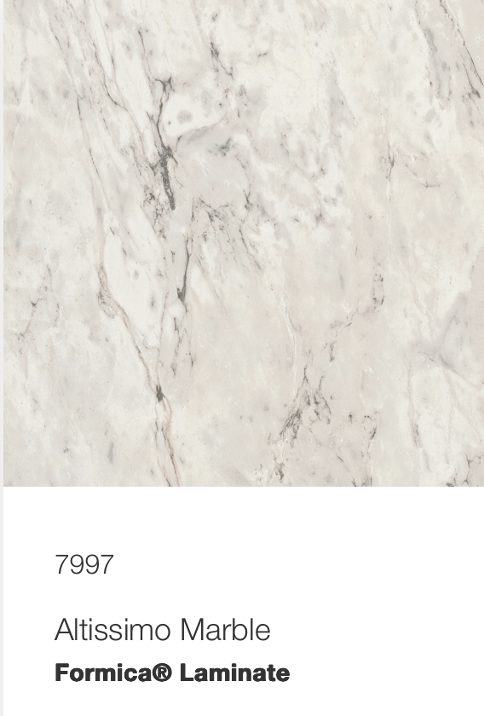
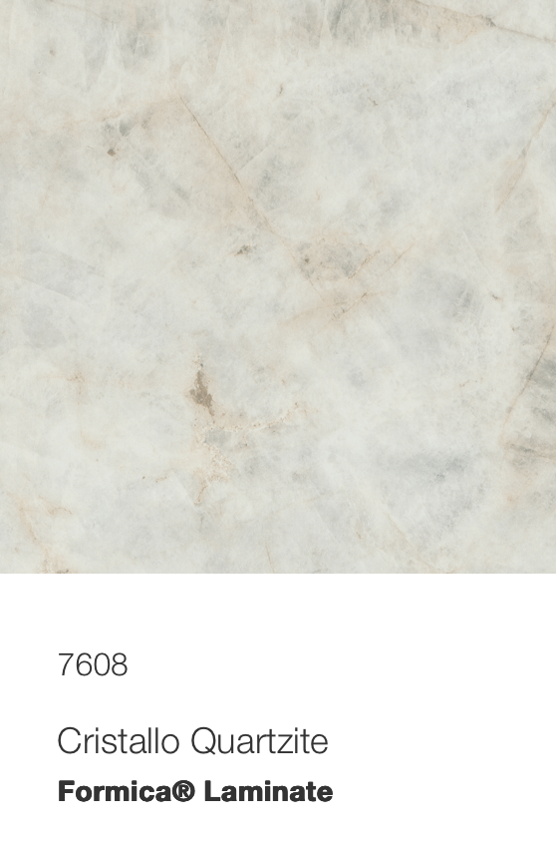
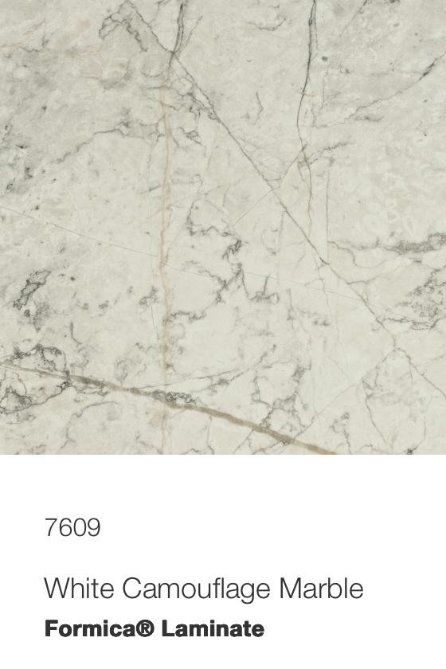
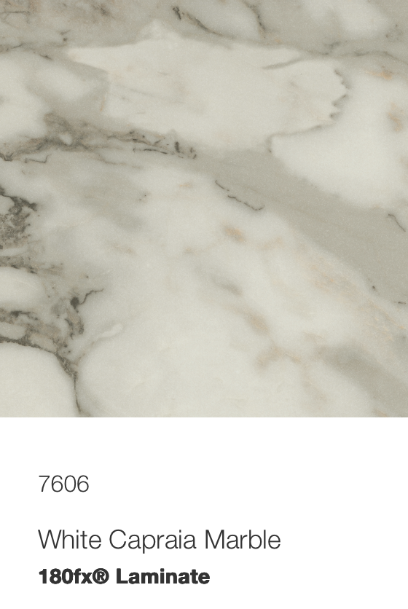
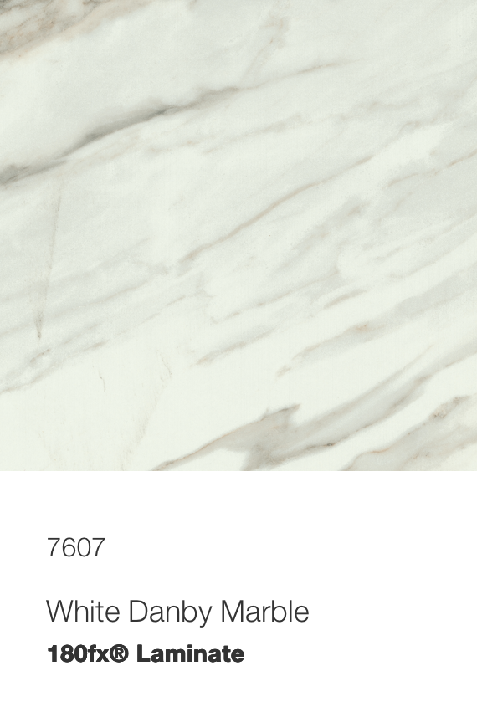
24
New Formica® Laminate Stones Collection

Slide 26
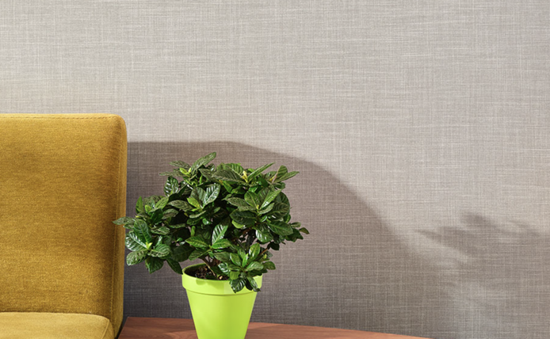
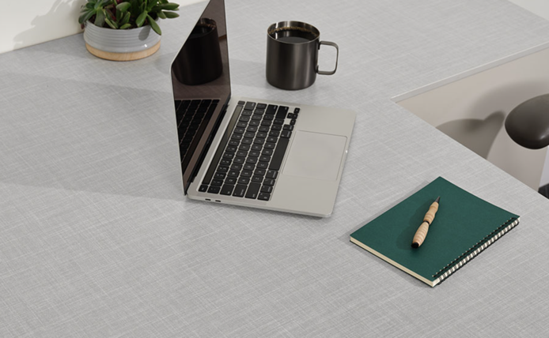
25
Formica® Laminate Fabric Collection
Product Page
A practical and versatile choice for commercial design that seeks warmth and effortless elegance along with durable, easily cleaned surfaces.
Includes four linen-inspired visuals including Chambray Fabric, Gray Fabric, Muslin Fabric and Sheer Fabric all for commercial use.
Remember, some patterns are inspired by fabrics, but they are high-pressure laminate products.

Slide 27
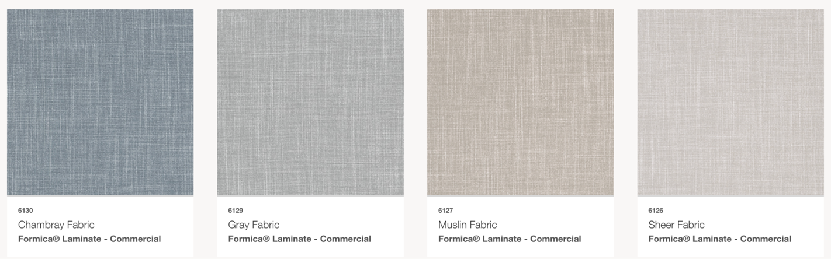
26
Formica® Laminate Fabric Collection

Slide 28
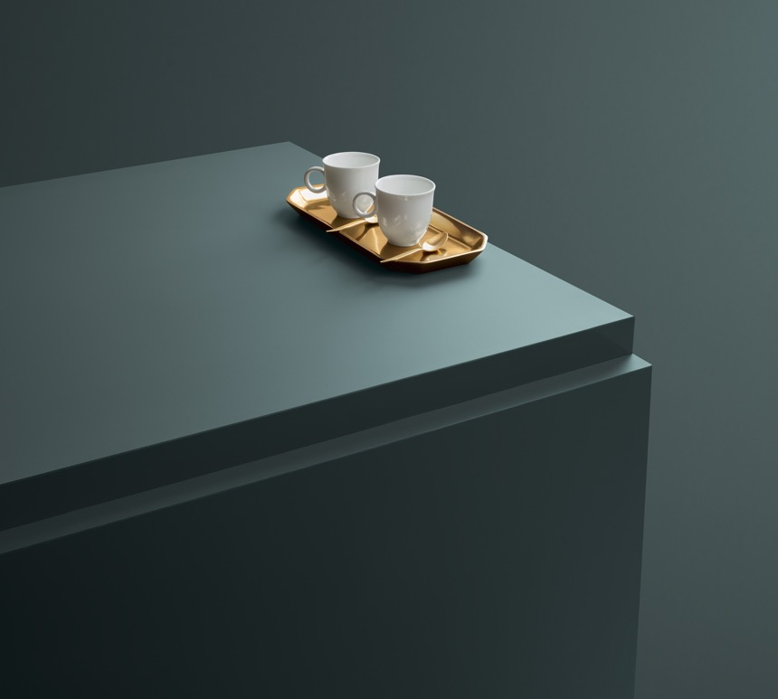
27
FENIX® Innovative Materials for Interior Design
Product Page
Perfect for commercial and residential designs due to its durability
Extremely opaque, soft touch and anti-fingerprint
Low light reflectivity
Thermal healing of superficial micro-scratches
The newly introduced FENIX® NTX collection marks a new era in sustainability by using breakthrough technology featuring up to 90% bio-based material

Slide 29
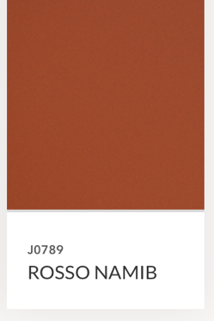
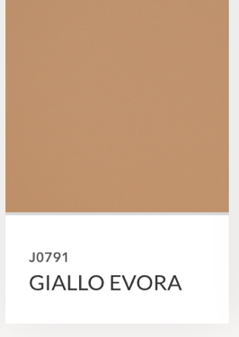
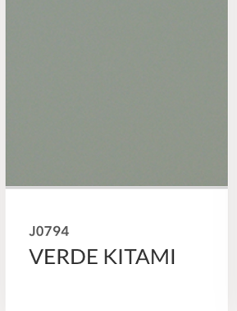
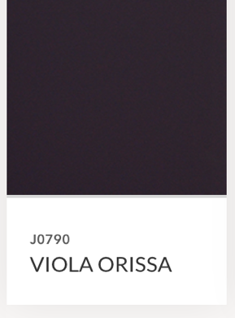
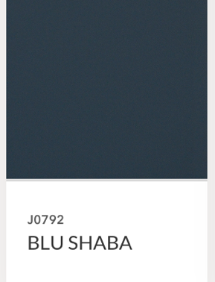
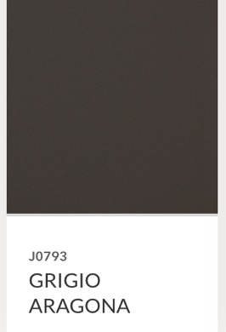
28
FENIX® Innovative Materials for Interior Design
*This represents a sampling of available colors

Slide 30
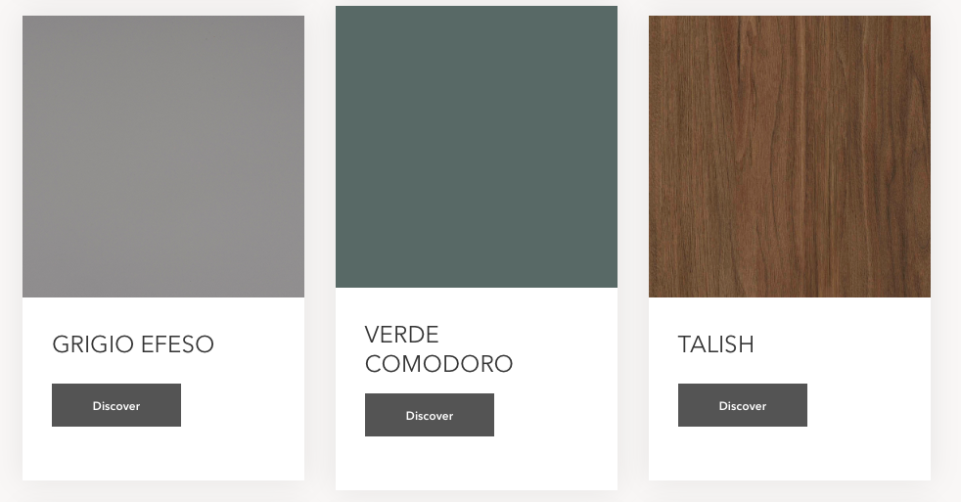
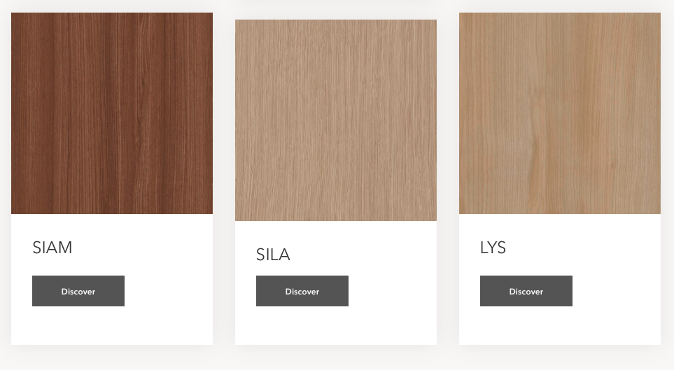
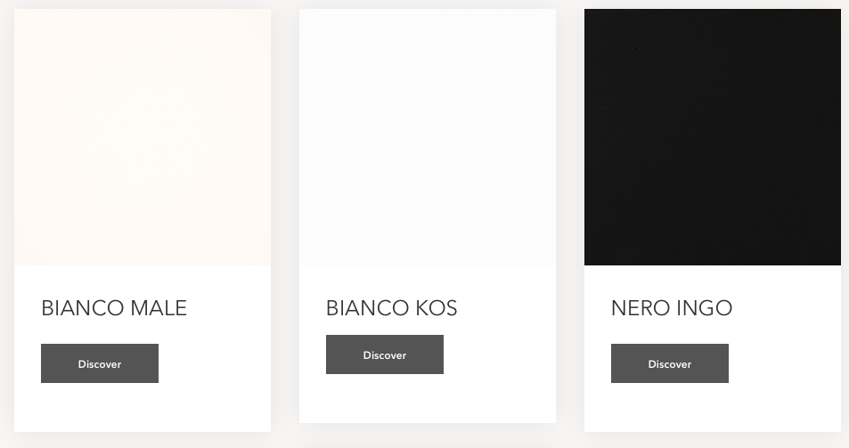
29
FENIX® NTX

Slide 31
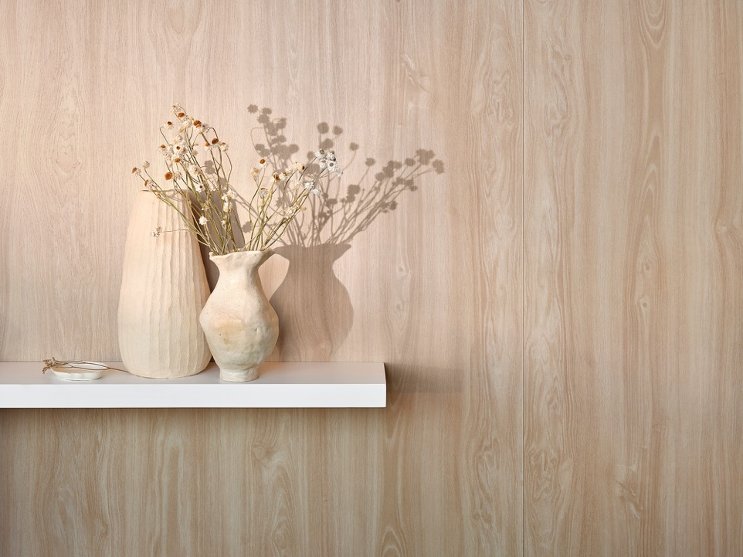
30
InDepth Surfacing™
Product Page
High-performance laminate surfaces draw the eye with luxe metallic elements, real wood veneer visuals and textural realism
Horizontal and vertical application
Postforming
Durable and wear-resistant
Impact-resistant

Slide 32
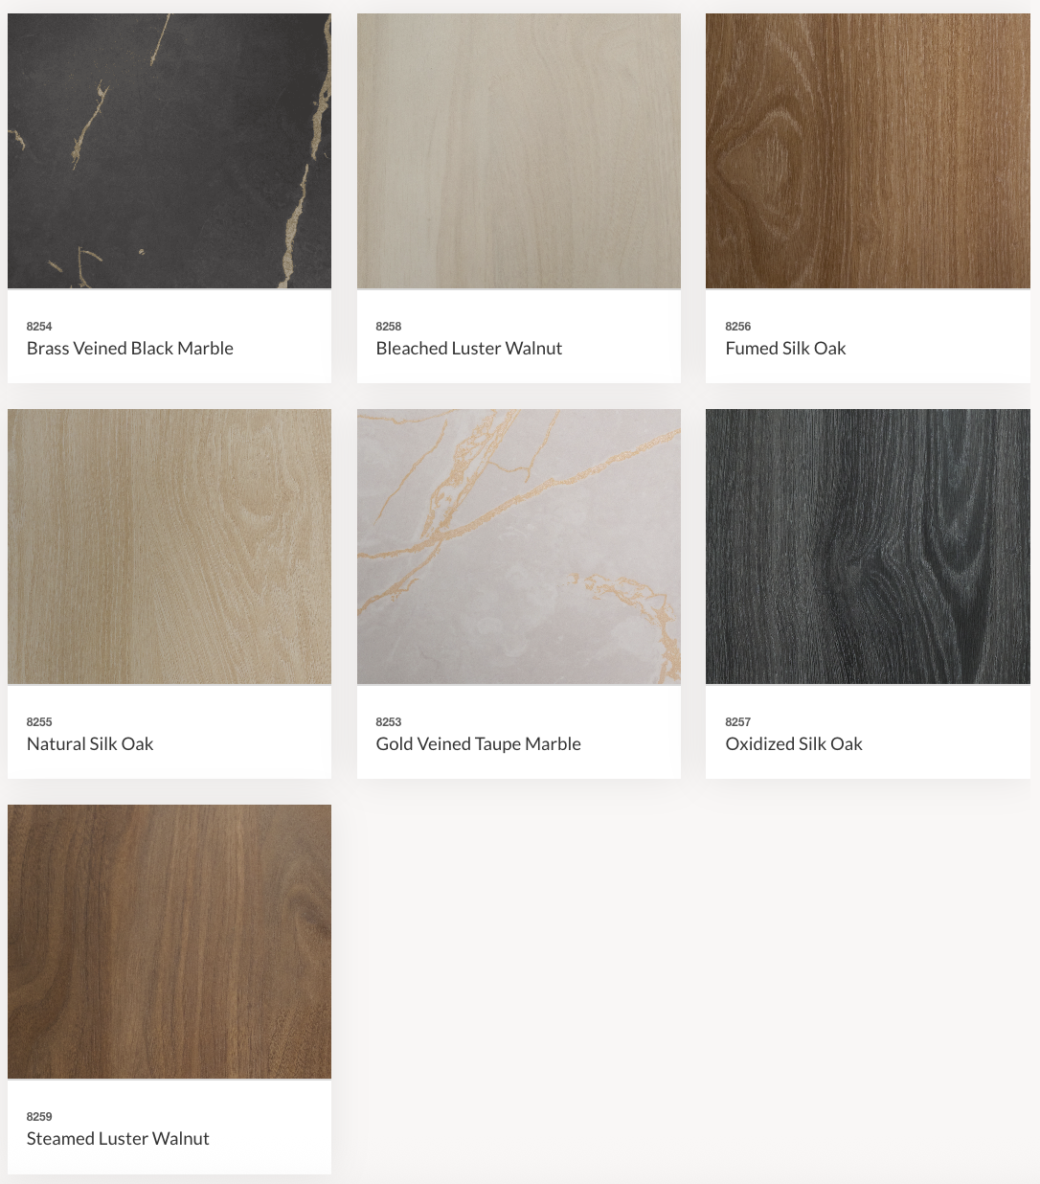
31
InDepth Surfacing™

Slide 33
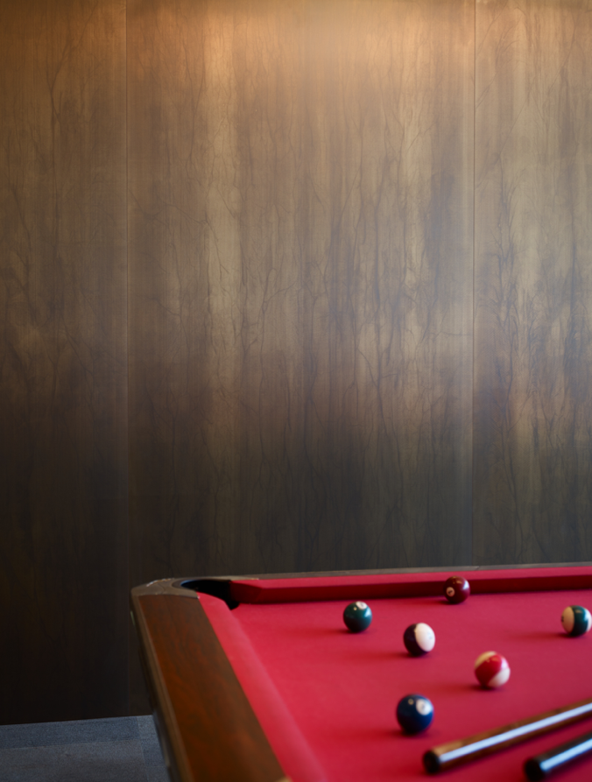
32
Homapal® Laminate
Product Page
Homapal® Laminate is a line of metal and metal-look laminates
This line offers glamorous colors and sheens with sophisticated textures designed for interiors that require high design and durability
Fire- and wear-resistant
Light-use horizontal and vertical application

Slide 34
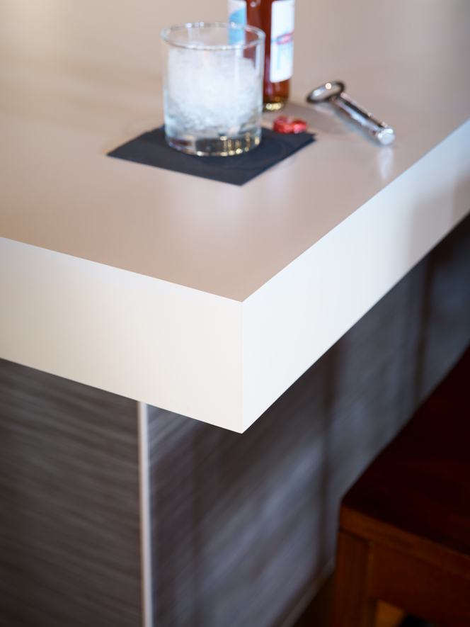
33
ColorCore®2 Laminate
Product Page
Features a matching-colored core that eliminates the brown edge typically seen with laminate
By eliminating the brown edge, often associated with standard laminate, ColorCore®2 offers professionals a functional solution with high performance that doesn’t sacrifice design
Horizontal and vertical application
Impact- and stain-resistant

Slide 35
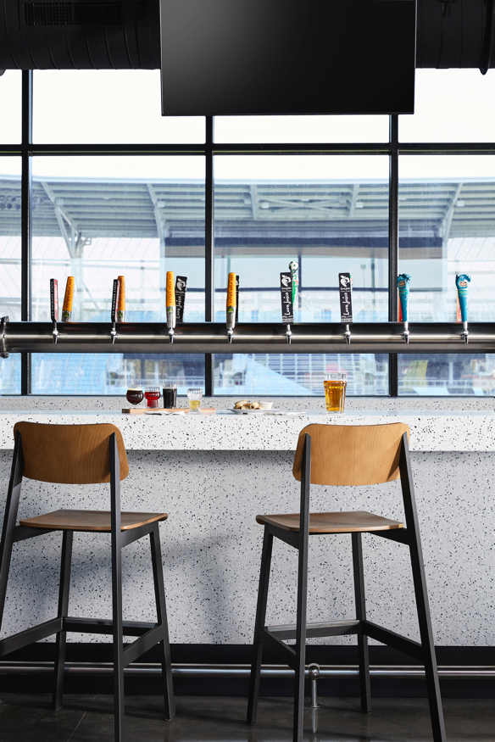
34
Everform® Solid Surface
Product Page
Everform® Solid Surface is an acrylic surface made from natural mineral fiber and binding resins that features color all the way through to its core
Seamless, nonporous, highly durable and repairable and water- and fire-resistant
Horizontal and vertical application

Slide 36
35
180fx®
Product Page
180fx® is an extension of traditional Formica laminate products that uses large-scale printing and scanning technologies for high-resolution patterns without a repeat
The designs are revolutionary in making true-to-scale granite, stone and wood grain patterns that offer visual drama that is unmatched by any other laminates
Impact- and wear-resistant
Horizontal and vertical application

Slide 37
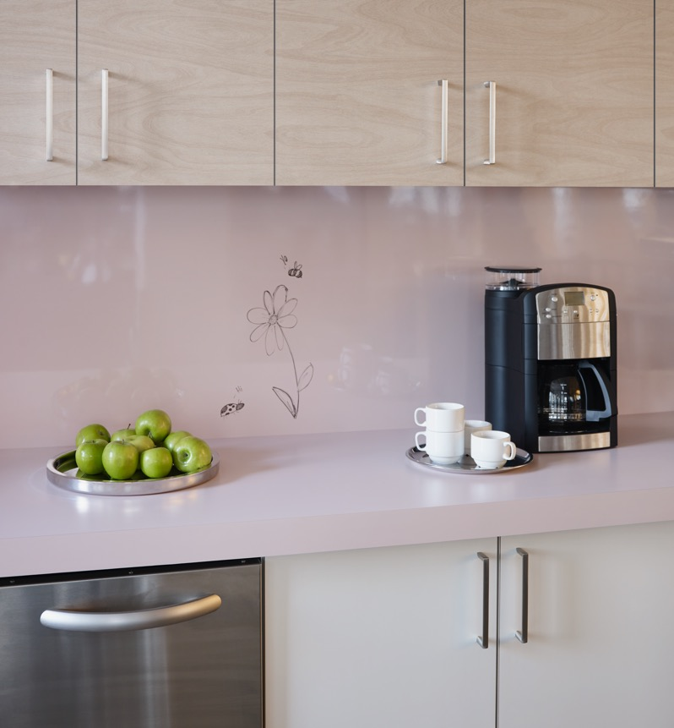
36
Formica® Markerboard
Product Page
Dry-erase surfaces that clean up instantly and are ideal for homes, offices and education settings
Durable and easy to maintain
High-gloss
Non-magnetic
Stain-resistant
Horizontal and vertical application

Slide 38
37
Sustainability Commitment
Formica Corporation continually strives to create innovative products that support sustainable design and contribute to a healthier environment.
Formica Corporation will reduce its water footprint by 5% in the next five years.
Formica Corporation pledges to publish its environmental impact data every year, along with targets and initiatives for the coming year.
Formica® Products are LEED®, FSC® Certified Wood, and GREENGUARD certified.
Formica Corporation earned the U.S. Department of Agriculture (USDA) Certified Biobased Product Label for Formica® Brand Laminate, certifying it to contain 72% biobased content and affirming Formica Corporation’s ongoing commitment to advancing sustainable materials in modern surfacing (read more here).
You can find more information on the Formica website here.

Slide 39
38
Previous Winning
FORM Competition Designs

Slide 40

39
2026 Winning Design: VIVO
VIVO, a versatile furniture piece primarily designed for children that supports a range of activities, encouraging creativity, play and self-expression while fostering independence and exploration. Thoughtfully designed for children of varying sizes, its components can be arranged to suit different needs and engage users in multiple ways. With its rounded forms and soft blue and white palette, VIVO creates a calming, luminous atmosphere that inspires joy.

Slide 41

40
2025 Winning Design: Playce
Playce, an indoor children’s playhouse and desk combo, is designed to spark creativity in children while bringing fun to any space. Featuring a unique roof covered in colorful Formica® Laminate shingles, it adds a playful touch with vibrant hues that brighten any room.

Slide 42

41
2024 Winning Design: Notions
Inspired by midcentury modern design, Notions encapsulates the mantra of the design movement: form follows function. Focused on maximizing functionality in a small footprint, Notions creates Newstalgia by drawing inspiration from midcentury modern sewing boxes, bringing that practicality and streamlined design into a piece made for modern living.

Slide 43

42
2023 Winning Design: Voulta
This striking furniture piece showcases a combination of harmonious curves and vivid colors, embodying the essence of maximalist design. Crafted from high-quality laminate, Voluta offers a stylish solution for storing and enjoying vinyl records.

Slide 44

43
2022 Winning Design:
Twins Table
The Twins Table was created for homeowners who need flexible, multipurpose furniture that allows them to seamlessly transition between functions. The Twins Table was made using Formica Laminate, which offers a broad range of looks.

Slide 45

44
2021 Winning Design:
Toboom
A multifunctional piece of furniture designed to provide children with space for play, work, storage and relaxation. In the future, spaces for children will have to be more versatile due to strong growth demographic, while teleworking will become part of the daily life of parents. This need for multifunctionality will be sought to allow more independent learning.

Slide 46

45
2020 Winning Design:
Origami
Modular art at its simplest. Birds, flowers, animals — all represented by the simple manipulation of a sheet of paper, the raw material of this work. Origami allows you to play with shapes and volumes, which causes this desk to challenge proportions. This ancestral art of Japan aims to be educational and evolving, in the very image of this creation.

Slide 47

46
2019 Winning Design:
The Shrug Chair
Inspired by the bent plywood furniture of the midcentury, this design has a comfortable aesthetic that invites patrons to “shrug off” their cares in a chair designed for residential or commercial spaces. The curved nature of the chair allows for more relaxation as wide-spanned arms give the user more room to rest their upper body.

Slide 48

47
2018 Winning Design:
Deflextion
Deflextion, the winner of the very first FORM Student Innovation Competition, was a unique chair meant to give the illusion of movement as it is observed from every angle and use. This design was inspired by origami forms.

